Slide 1
Securing the Perimeter:
10/23/2024
Cyber Defense through Physical Assessments
A.J. Kelly
Senior Principal DT Security Analyst, Cyber Assessment Team
Notes:
Introduce myself
Have been working in cybersecurity since 2004.
Air Force, Federal Contractor, Amtrak
Conducted assessments with dozens of organizations and several countries

Slide 2
Contents
Physical Security Overview
Why We Need Cyber-Physical Assessments
Types of Cyber-Physical Assessments
Developing a Cyber-Physical Assessment Program
Tools & Technologies
Challenges & Solutions
Scenario

Slide 3
Physical Security Overview

Slide 4
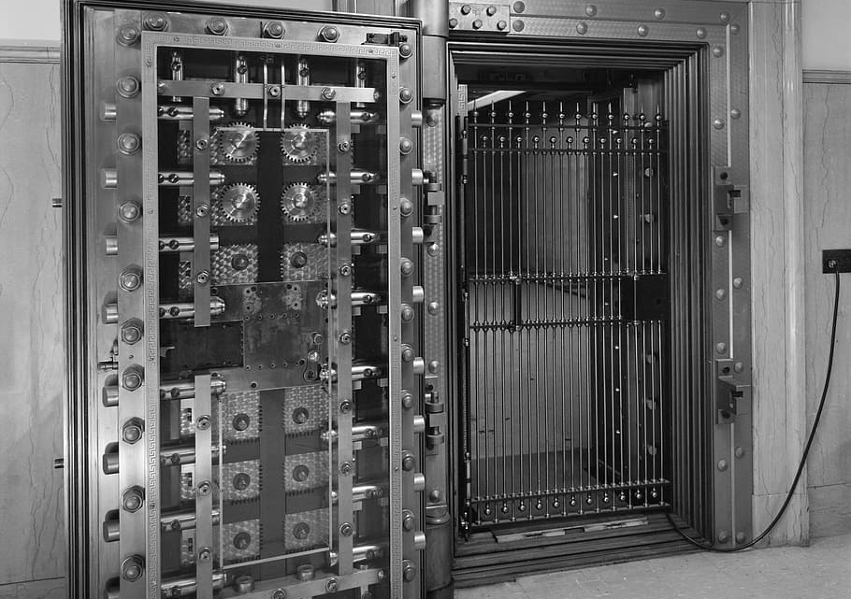
Physical Security – An Overview
Protecting People, Assets, and Information
Guarding Against Physical Threats
Core Components of Physical Security
Notes:
Purpose
At its core, physical security protects people, assets, and information from physical actions or events that could cause harm or damage. This includes things like unauthorized access, theft, vandalism, and natural disasters.
Physical security involves measures like barriers, surveillance, access control, and response protocols to create a safe and secure environment.
Types of Physical Threats
Physical threats range from unauthorized entry and internal sabotage to environmental hazards like fire and flooding. Each threat requires specific countermeasures to prevent or mitigate potential impacts.
Key elements of physical security include access control systems, alarm systems, surveillance cameras, and on-site security personnel.
Core Components
Deterrence measures that discourage potential threats such as signage, security lighting, visible surveillance cameras, and locked fences, doors, and gates
Access control mechanisms that regulate who can enter or exit specific areas
Surveillance & Intrusion detection systems that monitor an area to detect and allow a response to suspicious behavior or for incident investigation
Processes and procedures that describe how the environment is setup and what actions are allowed or disallowed
Personnel who enable everything else to function properly

Slide 5

The Intersection of Physical Security and Cybersecurity
Physical Security as a Cyber Defense Layer
Physical Threats to Digital Assets
Why Integrate Physical and Cybersecurity?
Notes:
How Physical Security Supports Cybersecurity:
Physical security acts as the first line of defense for cyber assets by preventing unauthorized access to areas like data centers, control rooms, and IT equipment.
Physical breaches can lead directly to cyber breaches. For example, if someone gains access to a server room, they could potentially install a rogue device, load malware onto unlocked terminals, or steal data.
The Need for Integration:
Physical and cybersecurity integration is essential for a holistic security posture. Without physical security, cyber defenses are vulnerable. Physical security is emphasized in frameworks like the NIST Cybersecurity Framework and ISO 27001, which highlight physical access controls as a key component of cybersecurity.

Slide 6

Why Physical Security Matters in Rail and Transit
Unique Challenges in Rail and Transit Security
Protecting Critical Infrastructure
Ensuring Safety for Passengers and Staff
Notes:
Challenges in Rail and Transit:
Rail systems cover vast, open spaces that are often difficult to secure comprehensively. Additionally, the mix of public access and critical infrastructure creates unique security challenges.
Rail infrastructure, including tracks, stations, and control systems, is often spread over large areas, making it vulnerable to physical threats like trespassing, vandalism, and sabotage.
Critical Infrastructure Protection:
Rail systems are considered critical infrastructure. Disruptions to physical security can impact public safety, lead to service disruptions, and, in severe cases, result in significant economic losses.
Physical security measures in rail must account for both safety (protecting people from harm) and security (protecting assets and operations from disruption).
Passenger and Staff Safety:
A secure rail environment ensures passenger and staff safety, preventing incidents that could harm individuals or disrupt operations. Effective physical security protects against both intentional acts (like sabotage) and accidental events (like natural disasters).

Slide 7

Cybersecurity Implications for Rail Systems
Cyber-Physical Risks in Transit
Potential Threats: Sabotage, Espionage, and More
Integrating Physical Security into Cyber Defense
Notes:
Understanding Cyber-Physical Risks:
Rail systems increasingly rely on digital controls for operations like signaling, ticketing, and surveillance. Physical breaches can compromise these cyber components, leading to potential system failures or data breaches.
Physical access to critical systems, like signaling controls or servers, can be exploited by attackers to disrupt services or exfiltrate sensitive data. For example, gaining physical access to a network room can allow an intruder to intercept communications or install malicious hardware.
Types of Threats:
Threats include sabotage (disrupting operations), espionage (stealing sensitive data), and even terrorist acts. These can have devastating impacts, especially given the high visibility and public nature of rail systems.
Cyber-Physical Security Integration:
In the context of rail, physical security acts as a cyber defense by protecting key systems from unauthorized access. A breach in physical security could lead to data breaches, service disruptions, or even safety incidents. For example, ensuring access to control systems is restricted only to authorized personnel can prevent tampering and protect against cyber threats.

Slide 8
Physical Breaches In the News
In 2022 Lawfare Media highlighted that rail systems have faced significant cyber threats with physical security implications, such as the potential for hackers to access locomotive control systems through passenger cabin entertainment systems. The complexity of the rail industry's infrastructure, often featuring outdated components, makes it vulnerable to such cyber-physical threats. This includes physical breaches that could allow access to digital systems​. Emerging Cyber Threat to the American Rail Industry
Xage Security reported on several incidents in 2022 where freight and passenger rail systems were targeted by cyberattacks that leveraged physical vulnerabilities. For example, a ransomware attack in Belarus disrupted train operations, illustrating how hackers exploited interconnected physical and cyber systems. This report also emphasizes the risks of physical breaches leading to significant operational disruptions in rail systems globally​. Security Lessons Learned from Three Cyberattacks Against Freight and Passenger Railroads in 2022
In 2019, the Rail Security Alliance discussed how physical security vulnerabilities in transit systems can pose national security risks, especially when foreign state-owned enterprises are involved in building or maintaining critical rail infrastructure. Such vulnerabilities could lead to data collection on passengers or even sabotage​. US Freight Rail and Transit Cyber Vulnerabilities

Slide 9
Why We Need Cyber Physical Assessments

Slide 10

Why Conduct Cyber Physical Security Assessments?
Identify and Mitigate Physical Vulnerabilities
Protect People, Assets, and Operations
Ensure Compliance with Security Standards
Notes:
Identifying Vulnerabilities:
Physical security assessments help uncover weaknesses in existing security measures that could be exploited. By regularly assessing physical security, organizations can proactively address gaps, reducing the likelihood of incidents.
These assessments reveal issues such as inadequate surveillance coverage, malfunctioning access control systems, or insufficient perimeter defenses.
Protection Objectives:
Physical assessments aim to protect not just physical assets, but also people and operations. This holistic view ensures that all potential risks—whether they impact physical or digital assets—are considered and addressed.
For example, securing access points and restricting entry to critical areas minimizes the risk of unauthorized access, theft, or sabotage that could impact both safety and operational continuity.
Compliance Requirements:
Many industries have specific standards for physical security, such as ISO 27001 for information security, NIST SP 800-53 for federal information systems, or TSA directives for critical infrastructure. Regular assessments ensure that organizations remain compliant with these regulations, avoiding penalties and enhancing overall security.
Beyond regulatory compliance, these assessments reinforce organizational commitment to security, fostering trust with stakeholders, partners, and customers.

Slide 11

Benefits of Cyber-Physical Assessments
Validate Security Controls
Process Improvement
Identify Attack Vectors
Notes:
Validate Security Controls
Physical assessments help ensure that security controls are working as intended. This includes verifying that access control mechanisms, like badge readers and locks, are functioning properly and providing the intended level of security.
By testing these controls in a real-world context, you can uncover weaknesses or malfunctions that might otherwise go unnoticed, enhancing both physical and cybersecurity.
Process Improvement
Assessments reveal not only security vulnerabilities but also opportunities for process improvement. For instance, if you find that access logs are inconsistently maintained, you can improve procedures to ensure accurate record-keeping.
This continuous improvement strengthens your organization’s overall security posture, as refining processes helps reduce gaps and enhances compliance with security standards.
Identify Attack Vectors
Physical assessments identify potential entry points or methods that attackers might exploit to gain unauthorized access. For example, you might discover that certain areas are inadequately monitored, creating vulnerabilities that could be used to access sensitive systems.
Understanding these attack vectors allows for targeted defenses, addressing weaknesses before they can be exploited and reducing the risk of security incidents that could impact cybersecurity.

Slide 12
Types of Cyber Physical Assessments

Slide 13

Discovery Assessments – You Don’t Know What You Don’t Know
Identify Future Assessment Needs
Determine Assessment Methods
Map Locations of Key Assets
Establish Contact with Key Stakeholders
Notes:
Identify Future Assessment Needs:
Discovery assessments are the first step in understanding the scope and scale of what needs to be assessed. This involves identifying all critical assets and areas that require security evaluation, such as data centers, server rooms, control centers, and any points of public access.
The purpose here is to get a big-picture view of what areas will need further, more detailed assessments in future phases. This helps in prioritizing which locations are the most critical.
Determine Assessment Methods:
After identifying what needs to be assessed, the next step is to outline potential methods for those future assessments. For example, if you’re dealing with access control points, you might consider testing badge systems or surveillance coverage.
This planning ensures that when you move into detailed assessments, you’ll have a clear approach in mind, tailored to the unique needs of each location or asset.
Map Locations of Key Assets:
Discovery assessments also involve mapping out where key assets are physically located within the environment. This could include mapping out the layout of critical areas, entrances, exits, and high-traffic zones.
A thorough understanding of physical locations helps in identifying vulnerabilities, such as unmonitored areas or potential access points for unauthorized individuals.
Establish Contact with Key Stakeholders:
Finally, it’s essential to identify and engage with stakeholders who have knowledge of, or access to, the areas you plan to assess. This includes facility managers, security teams, and IT personnel who can provide insights and support during the assessment process.
Building these connections early helps ensure that when detailed assessments are conducted, you have the cooperation and information needed to effectively evaluate each area.

Slide 14

Station Assessments – Securing High Traffic Areas
Focus on Public Access Points
Surveillance and Access Control
Notes:
Challenges of Station Security:
Stations are high-traffic areas that are accessible to the public, making them vulnerable to various threats, including unauthorized access, vandalism, and even terrorism. Station assessments focus on safeguarding these busy hubs.
The public nature of stations requires a balance between security and convenience. Security measures should be robust yet unobtrusive, maintaining smooth passenger flow while mitigating risks.
Key Assessment Areas:
Access Points: Evaluate entrance and exit controls, including turnstiles, ticket barriers, and emergency exits. Secure access points ensure only authorized personnel can enter restricted areas.
Surveillance: Assess camera coverage and positioning to ensure all critical areas, such as platforms, ticketing areas, and entry points, are monitored. Blind spots can be exploited by malicious actors, so surveillance must be comprehensive.

Slide 15

Rail Yard Assessments – Securing Operational Hubs
Perimeter and Access Control
Protecting Rolling Stock and Equipment
Surveillance and Lighting
Notes:
Perimeter Security: Assess the integrity of perimeter fences and gates. Look for gaps, breaches, or areas that could be climbed or circumvented. Secure perimeters prevent unauthorized access to valuable assets and operational areas.
Asset Protection: Evaluate measures in place to protect rolling stock, tools, and equipment. This may include secure storage areas, locks on rail cars, and tamper-evident seals on equipment.
Surveillance and Lighting: Rail yards often operate around the clock, requiring effective lighting and camera coverage. Assess camera placement and lighting to ensure that all areas are visible, especially at night or during low-visibility conditions.

Slide 16

Office and Employee Area Assessments – Protecting Sensitive Information
Securing Administrative and Employee-Only Areas
Access Controls and Visitor Management
Data Protection and IT Security
Notes:
Why Secure Office and Employee Areas:
Office areas within rail organizations often contain sensitive information, such as employee records, operational plans, and IT infrastructure. Employee-only areas can also provide access to critical systems. Securing these areas is essential for both physical and cybersecurity.
These assessments focus on preventing insider threats, unauthorized access, and data breaches. Access control measures should be reviewed to ensure only authorized personnel have access to sensitive areas.
Key Assessment Areas:
Access Controls: Check badge systems, visitor logs, and entry procedures to ensure robust access control for employee areas. Unauthorized access to offices or server rooms can lead to cyber breaches or data theft.
Visitor Management: Assess how visitors are managed, including check-in procedures, identification checks, and escorted access to restricted areas. Effective visitor management reduces the risk of unauthorized access by non-employees.
IT Security: Evaluate the physical security of IT assets, like servers, workstations, and network equipment. Secure storage, cable management, and environmental controls contribute to the protection of both physical and digital assets.

Slide 17
Developing A Cyber Physical Assessment Program

Slide 18

Staring with Ad Hoc Assessments
Targeting High-Risk Areas First
Learning from Early Findings
Building the Case for a Formal Program
Notes:
Taking the First Steps:
Every security program has to start somewhere. In this case, begin by targeting high-risk or critical areas with ad hoc assessments. These initial steps provide a quick look at vulnerabilities in places like control rooms or main stations where risks are highest.
The findings from these assessments will help build a case for establishing a formal assessment program. Highlight immediate vulnerabilities to showcase the value of physical security.
Learning and Adapting:
Each assessment provides insights, helping the team understand what’s working and what needs improvement. These early discoveries lay the groundwork for a more comprehensive approach.
For example, finding an easily accessible entry point or unmonitored area provides concrete evidence that can be shared with leadership to advocate for a formal program.

Slide 19

Reporting Findings to Leadership
Communicating Risk and Impact
Using Data to Demonstrate Value
Securing Buy-In for Expansion
Notes:
Making the Case with Data:
After conducting ad hoc assessments, it’s essential to communicate findings to leadership. Use clear metrics like risk levels, potential impacts, and compliance gaps to paint a picture of the organization’s physical security landscape. It is important not to throw anyone under the bus when you do this. Typically, initial findings are indicative of systemic issues, not the fault of any one person or group of people.
Emphasize the connection between physical vulnerabilities and broader operational risks. For example, the potential impact of unauthorized access to a rail yard or control center can resonate when tied to operational disruptions or financial losses.
Securing Buy-In:
Present the data in a way that underscores the importance of expanding the program. Show how a systematic approach will not only reduce risk but also protect against potential fines and reputational damage.
By communicating the tangible benefits of a formalized program, such as enhanced safety and compliance, leadership is more likely to support resource allocation for a broader initiative.

Slide 20

Developing a Targeted Assessment Plan
Prioritizing Based on Risk and Impact
Aligning Resources with Security Needs
Creating a Roadmap for Future Assessments
Notes:
Risk-Based Planning:
With leadership on board, the next step is to develop a targeted plan that prioritizes areas based on risk and operational impact. This includes evaluating factors like asset value, traffic volume, and potential for unauthorized access.
The goal is to create a roadmap that aligns security needs with available resources. For example, areas with critical infrastructure or high-value assets might be assessed more frequently than lower-risk areas.
Creating a Sustainable Roadmap:
Lay out a phased approach for assessments, beginning with high-priority areas. This roadmap should be adaptable, with the flexibility to adjust as new risks or resources emerge.
By creating a clear plan, the team can work systematically, ensuring that each part of the rail environment receives the attention it needs.

Slide 21

Engaging Stakeholders - Building a Security Network
Identify Key Stakeholders
Collaborate with Physical Security Teams
Involve Facility Managers and Law Enforcement
Notes:
Building a Network of Support:
Physical security isn’t a one-team job; it requires collaboration across departments and, in some cases, with external partners. Identify key stakeholders, such as physical security teams, facility managers, and law enforcement, who have a role in maintaining security.
Establishing these relationships early ensures that everyone understands their role in the program and is prepared to contribute.
The Value of Collaboration:
Engaging stakeholders allows the program to tap into various expertise. Facility managers, for example, have intimate knowledge of the layout, while physical security teams bring experience with day-to-day security operations.
Including law enforcement, when appropriate, provides additional support for handling incidents or planning for high-risk situations, especially for large events or high-traffic times.

Slide 22

Starting with Compliance Checks - Setting a Baseline
NIST SP 800-53 and ISO 27k series
Creating Checklists for Consistency
Establishing Minimum Security Standards
Notes:
Setting a Security Baseline with Compliance:
Compliance checks are based on general risk within the industry. If you do not already have a set of security policies or standards or the security policies and standards are incomplete, consider using compliance checks from standards such as these and tailoring them to your environment.
Compliance checks based on standards like NIST SP 800-53 and ISO 27002. These standards provide a structured approach for evaluating physical security measures and aligning them with best practices.
Compliance checklists help establish consistency, ensuring that each assessment meets minimum security standards and addresses key vulnerabilities.
The Value of a Compliance Framework:
These initial compliance checks provide a baseline that all future assessments will build upon. They also highlight areas where existing controls meet, exceed, or fall short of industry standards, guiding remediation efforts.
Once you have demonstrated value from reporting on compliance failures, it can be easier to push for policy and procedure updates that capture those standards.

Slide 23
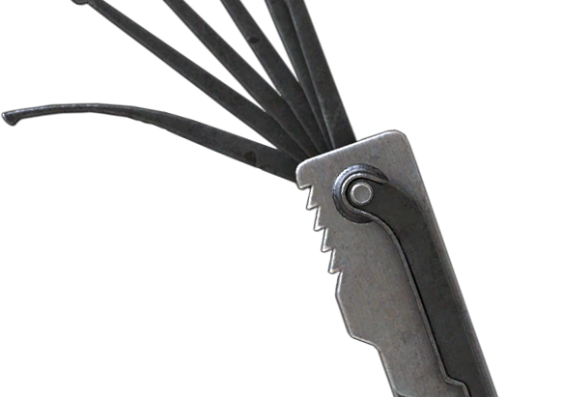
Evolving to Practical Security Checks
Testing Doors, Locks, and Sensors
Assessing Badge Systems for Vulnerabilities
Evaluating Surveillance for Blind Spots
Notes:
Beyond Compliance - Practical Testing:
Once compliance is established, it’s time to focus on practical checks that simulate real-world scenarios. This includes testing doors, locks, and sensors to ensure they can withstand attempts at unauthorized access.
Badge systems are also critical. By testing for cloning vulnerabilities or weak points, the team can identify ways to bolster access controls.
Practical Tests Provide Real Insights:
Practical assessments reveal vulnerabilities that compliance alone might miss. For instance, testing surveillance for blind spots can uncover areas where unauthorized access might go undetected.
These tests make security tangible, showing stakeholders the real risks present in their environment and driving home the importance of robust physical defenses.

Slide 24

Communicating Results and Closing the Loop
Pre-Assessment Briefings
Post-Assessment Reporting and Recommendations
Continuous Improvement through Feedback
Notes:
The Role of Effective Communication:
Communication is crucial throughout the assessment process. Pre-assessment briefings ensure everyone understands the scope and goals, while post-assessment reports summarize findings and recommend actions.
Clear, actionable reports help stakeholders see the value of the program and understand their role in implementing security improvements.
Feedback and Continuous Improvement:
A program’s success depends on its ability to adapt and improve. Collect feedback from stakeholders after each assessment to refine processes and ensure assessments remain effective.
By creating a feedback loop, the team can continuously improve the program, adapting to new threats and refining strategies based on real-world experiences.

Slide 25
Tools & Technologies

Slide 26

Assessment Documentation
Standardized Compliance Checklists
Questionnaires
Assessment Plans
Notes:
Compliance Checklists:
Compliance checklists based on standards like NIST SP 800-53 and ISO 27002 are essential for structured assessments. They provide a framework for evaluating controls, ensuring consistency and thoroughness.
These checklists help assessors verify that all necessary controls are in place, addressing areas such as access controls, surveillance, and emergency preparedness.
Questionnaires:
Questionnaires can be sent out ahead of time to stakeholders to gather initial information about the location. These are typically incomplete but can really help to move a conversation forward by laying out exactly the information that you need.
Assessment Plans:
Assessment plans are high-level ideas for how your team wants to approach an assessment. It answers things like, “what time do we begin?”, “who are we meeting with?”, “what do we need to check?”
They communicate what your intentions are to keep everyone on the same page.
Plans are not straightjackets. If you’re out on an assessment and you identify something that wasn’t included in the original scope but impacts the assessment area, you can typically expand the scope to include new areas or assets.

Slide 27

Building Maps
Building Maps and Diagrams
Notes:
Building Maps and Diagrams:
Detailed maps and diagrams of buildings are critical for planning and conducting assessments. They allow the team to visualize entry points, camera placements, and restricted areas.
Building maps help in identifying potential vulnerabilities, like unmonitored access points, and aid in efficiently navigating the site during assessments.

Slide 28
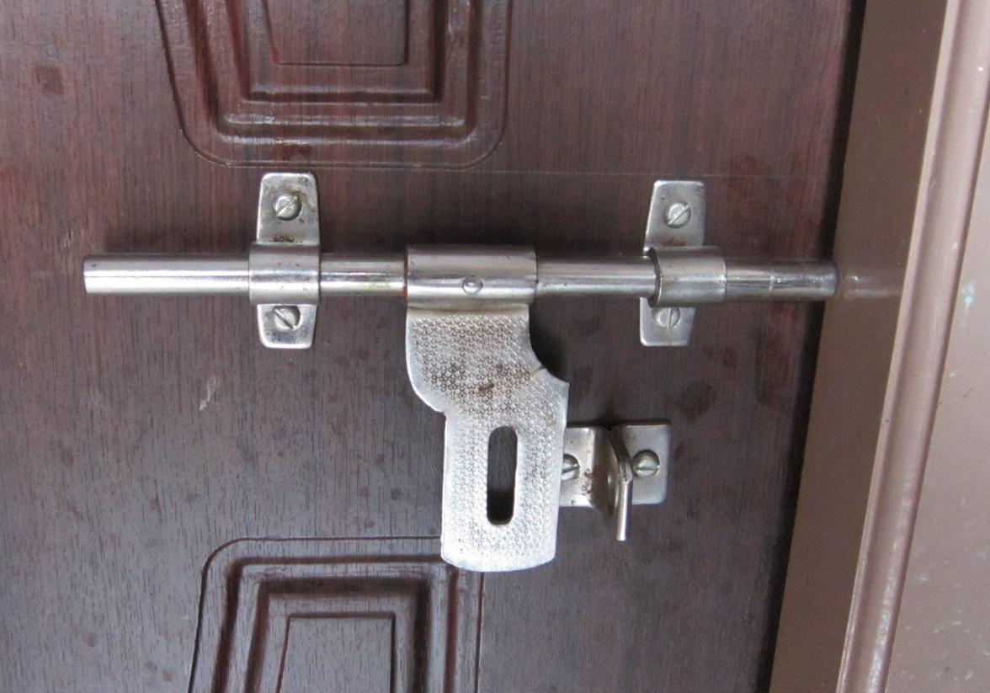
Testing Doors and Locks
Tools: Lockpicks, Under-the-Door Tool
Techniques: Exploiting Poor Latching, Tricking Exit Sensors
Goal: Identify Vulnerabilities in Physical Access Points
Notes:
Lockpicking: Lockpicking is a classic technique used to test the robustness of physical locks. By using lockpick sets, you can simulate an unauthorized entry attempt to see if locks are easily bypassed. This test identifies any low-quality or outdated locks that need upgrading.
Under-the-Door Tool: This tool is particularly useful for doors with interior push bars. It slides under the door and pulls down on the bar, unlocking the door without requiring access to the handle. This method reveals vulnerabilities in doors that lack adequate protections against unauthorized entry.
Exploiting Poor Latching: During assessments, you may encounter doors that seem secure but have poor latching mechanisms. By applying pressure or jiggling, you can test whether these doors can be pushed open without using a key or badge, identifying weaknesses in door frame alignments or worn-out hardware.
Tricking Exit Sensors: Exit sensors are typically used to automatically unlock doors for people exiting a secure area. By simulating a presence (often with a can of compressed air or a heat source), you can test if the sensor can be easily fooled from the outside. This helps in assessing the need for tamper-resistant sensors.

Slide 29

Badge Card Cloning
Tools: RFID/Bluetooth Cloners
Techniques: Cloning Access Cards, Testing Proximity Limits
Goal: Assess Access Control Security
Notes:
RFID Cloning Devices: Badge card cloning tests involve using RFID cloning devices to replicate access cards. These devices capture the RFID signal and clone it onto a blank card. If you’re able to clone and use the badge to gain unauthorized access, this indicates a need for stronger encryption or alternative access methods.
Bluetooth Proximity Cloning: With the rise of Bluetooth-enabled access cards, you can use Bluetooth scanners to test proximity vulnerabilities. This involves capturing and replicating Bluetooth signals within range, demonstrating how attackers might bypass physical access controls if they can approach within a certain distance.
Testing Proximity Limits: Badge readers that operate with RFID or Bluetooth often have specific ranges. By experimenting with various distances, you can test how far an attacker would need to be to capture and clone a badge signal. This helps in assessing whether physical barriers or reduced signal strength could prevent unauthorized access.

Slide 30
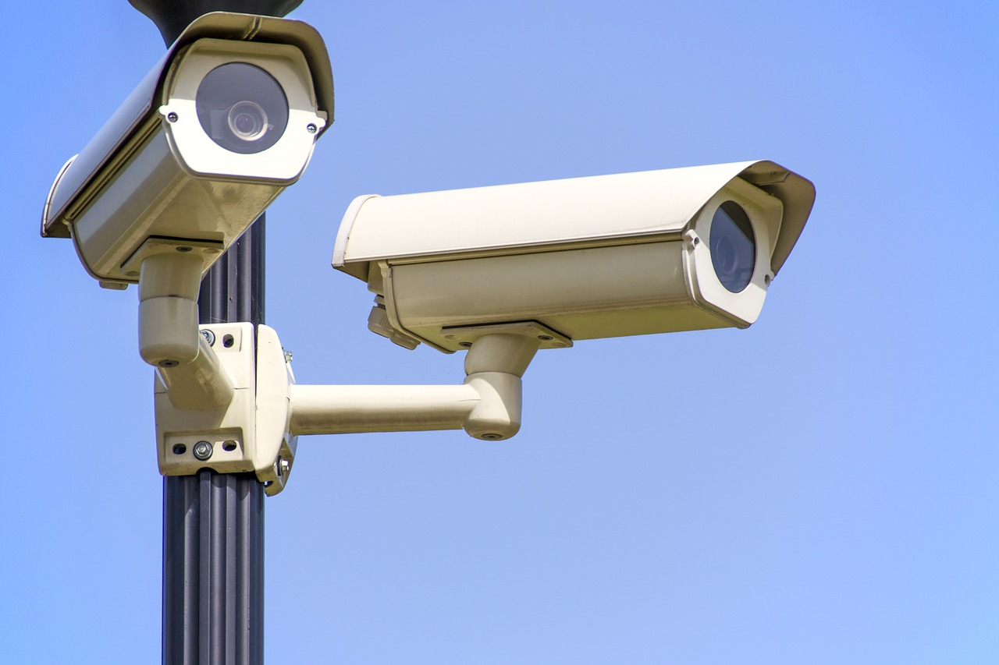
Identifying Surveillance Blind Spots
Tools: Surveillance Camera Monitors, Physical Walkthrough
Techniques: Mapping Camera Coverage, Identifying Unmonitored Areas
Goal: Enhance Surveillance Coverage and Security
Notes:
Surveillance Camera Monitors: Using camera monitors, you can review real-time footage to check for blind spots. By observing camera angles, you can identify areas that fall outside the surveillance field, such as corners, under staircases, or behind large objects. This helps in determining where additional cameras might be needed.
Physical Walkthroughs: Physically walking through the area and observing camera placements allows you to identify areas that aren’t visible on camera. This includes testing different angles and heights to ensure complete coverage. Blind spots can provide intruders with hiding spots or access routes, so minimizing them is crucial.
Mapping Camera Coverage: Create a map or diagram of the camera layout and annotate it with identified blind spots. This visual representation helps in communicating vulnerabilities to stakeholders and planning for camera repositioning or additional coverage where necessary.

Slide 31

Social Engineering Techniques for Physical Assessments
Techniques: Pretexting, Tailgating, Impersonation
Tools: Props, Fake IDs, Persona Building
Goal: Test Human Vulnerabilities in Security Protocols
Notes:
Pretexting: Pretexting involves creating a fabricated scenario to gain trust or access. For example, posing as a delivery person or maintenance worker provides a plausible excuse to enter restricted areas. Assessors can test how well employees follow protocols when dealing with unexpected visitors.
Tailgating: Tailgating is a common tactic where an unauthorized person follows an authorized individual into a secure area, exploiting their courtesy. This tactic tests whether employees challenge individuals they don’t recognize and follow security procedures for escorting guests.
Impersonation: Impersonation goes a step further by using props or fake identification to blend in. For instance, wearing a uniform or using a fake ID badge can help assessors gain access. This tests the effectiveness of visual ID checks and staff awareness of proper identification protocols.
Using Props and Persona Building: Props, like toolkits or equipment bags, can make the assessor’s role more believable. Building a credible persona involves researching details that reinforce the pretext, such as knowing specific employee names or recent company projects.
Goal of Social Engineering in Physical Assessments: The purpose of these tests is to identify gaps in human awareness and adherence to security protocols. By simulating social engineering attacks, organizations can train employees to be vigilant and reduce the risk of unauthorized access through manipulation.

Slide 32

Documenting Tools
Portable Document and Note Tools
Camera
Notes:
Portable Document and Note Tools:
Portable tools, like tablets or specialized apps, allow assessors to document findings in real-time, annotate building diagrams, and capture photos or videos. These tools streamline data collection and enhance the accuracy of reports.
They also facilitate easy sharing of information with stakeholders, making it simple to communicate findings and recommendations.
Camera:
Documenting your work with a camera is very helpful in later communicating what you saw or experienced while conducting the assessment. Typically, photographs suffice but sometimes, video is warranted to demonstrate a particular event.
Even though you probably have a pretty good camera on your phone, you may not be allowed to or want to mix your personal device with your work, particularly if you are photographing potentially sensitive information. You should always try to use organization-owned assets.

Slide 33
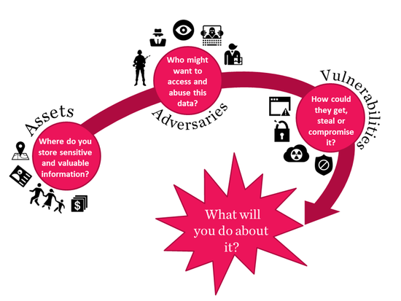
Threat Modeling and Automated Reporting
Threat Modeling and Analysis Tools
Automated Reporting Tools
Notes:
Threat Modeling and Analysis Tools:
Threat modeling tools help assessors understand potential risks, visualize attack paths, and anticipate how threats might evolve. These tools are invaluable for planning assessments and developing remediation strategies.
By mapping out potential threats, the team can prioritize vulnerabilities and focus on the most critical areas during assessments.
Examples include CARVER, OCTAVE, MS Threat Modeling Tool, RiskWatch
Automated Reporting Tools:
Automated reporting tools streamline the process of compiling assessment findings into comprehensive reports. These tools can generate visuals like heat maps, charts, and graphs, making it easier to communicate risks to stakeholders.
Automation ensures that reports are accurate and consistent, saving time and enabling assessors to quickly share actionable insights with decision-makers.
Examples include Resolver, iAuditor, or Dradis

Slide 34
Common Challenges

Slide 35
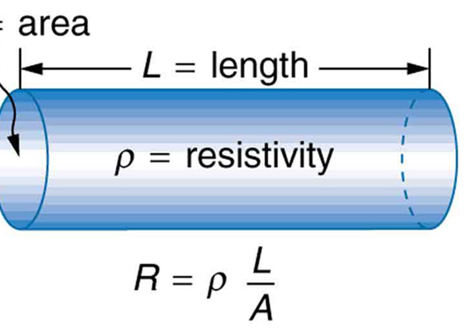
Challenge – Resistance from Staff
Solution: Educate and Involve Staff Early
Use Clear Communication and Transparency
Notes:
Understanding Staff Concerns:
Staff may resist physical security assessments due to concerns about privacy, disruptions, or lack of understanding. It’s crucial to address these concerns by educating and involving them in the process.
Clear communication about the purpose of assessments and how they enhance safety can help alleviate concerns. Transparency builds trust and fosters cooperation.
Involving Staff:
Involve staff early by explaining the benefits of assessments and how they contribute to overall security. Offer training on how they can support assessments and recognize potential vulnerabilities.
By engaging with staff and valuing their input, the program is more likely to gain their support and minimize resistance.

Slide 36

Challenge - Logistical Constraints
Solution: Plan and Prioritize Assessments
Leverage Remote Tools like Drones
Notes:
Planning for Logistics:
Logistical constraints, such as large areas to cover or limited access to certain zones, can pose challenges. Proper planning and prioritization help overcome these obstacles, focusing on the most critical areas first.
Use tools like drones to assess hard-to-reach places, such as rail yards or rooftops. This can provide valuable insights without requiring extensive manpower or time.
Remote Tools as a Solution:
Remote tools reduce the need for assessors to physically access every area, allowing for a more efficient assessment process. Drones and portable scanners can quickly survey large or difficult-to-reach spaces.

Slide 37
Challenge - Communicating Technical Findings to Non-Technical Stakeholders
Solution: Simplify Language and Use Visual Aids
Highlight Business Impacts and Benefits
Notes:
Effective Communication Techniques:
Translating technical findings into language that resonates with non-technical stakeholders is crucial. Avoid jargon and focus on the business impacts, such as potential risks to operations or financial implications.
Visual aids like heat maps, charts, and risk matrices can simplify complex information and help stakeholders grasp the significance of the findings.
Focus on Business Impacts:
Emphasize how addressing security vulnerabilities contributes to business objectives, like compliance and operational continuity. Highlighting the benefits can motivate stakeholders to support and invest in security improvements.

Slide 38
Questions?

Slide 39
THANK YOU
Alfred Kelly
Senior Principal DT Security Analyst, Cyber Assessment Team

