Slide 1




NEXT-GENERATION CYBERSECURITY PROTECTING OUR RAILROAD ECOSYSTEM
Presented by
KLEMENS GEIGER - Founder, Geiger Safe & Secure Engineering
JON “BART” SHIELDS - CEO, AKM Cyber Corporation
(c) 2024 McIndoe Risk Advisory | PROPRIETARY

Slide 2





INTRODUCTIONS
38 years as Founder, Team Manager, System Designer and Developer.
    Product Architect, significant experience, concept through deployment across multiple verticals, including Aerospace, Rail, Automotive, Wireless, Data Communications, and for the past 10+ years, cybersecurity.
  Responsible for development of several products, including, Real-Time Systems , IMA , and Audio & TV Solutions over their complete life cycle
  Customer communication and communication with homologation authorities
  Inventor of Autonomous Key Management (AKM) and Asset Integrity Management (AIM, the AKM Integrity Management extension for authenticating assets).
Klemens Geiger
Bart Shields
  Expert and Head of Center of Excellence Cyber Security in rail, as well as appointed as German representative and Author for -
    CENELEC WG TC9X A (7 years) , TC9X (7 years)
  Member & Lead deputy of UNIFE Cyber Security WG (9 years)
  Representative for ALSTOM at ERJU WG Cyber Security
  Multiple Start-ups
  Multiple Patents, including 3 issued for AKM, 1 filed for AKM in May, and another one for AKM is in process
  27+ years of Technical Leadership
(c) 2024 McIndoe Risk Advisory | PROPRIETARY
2

Slide 3
AGENDA
1
Today‘s Railroad Ecosystem
4
Inherent Cybersecurity Risks
2
Cybersecurity (Standards, Best Practices)
5
A Sustainable Solution for Rail (AKM + AIM)
3
Cybersecurity Solutions in Rail Today
6
Q&A
3
(c) 2024 McIndoe Risk Advisory | PROPRIETARY

Slide 4
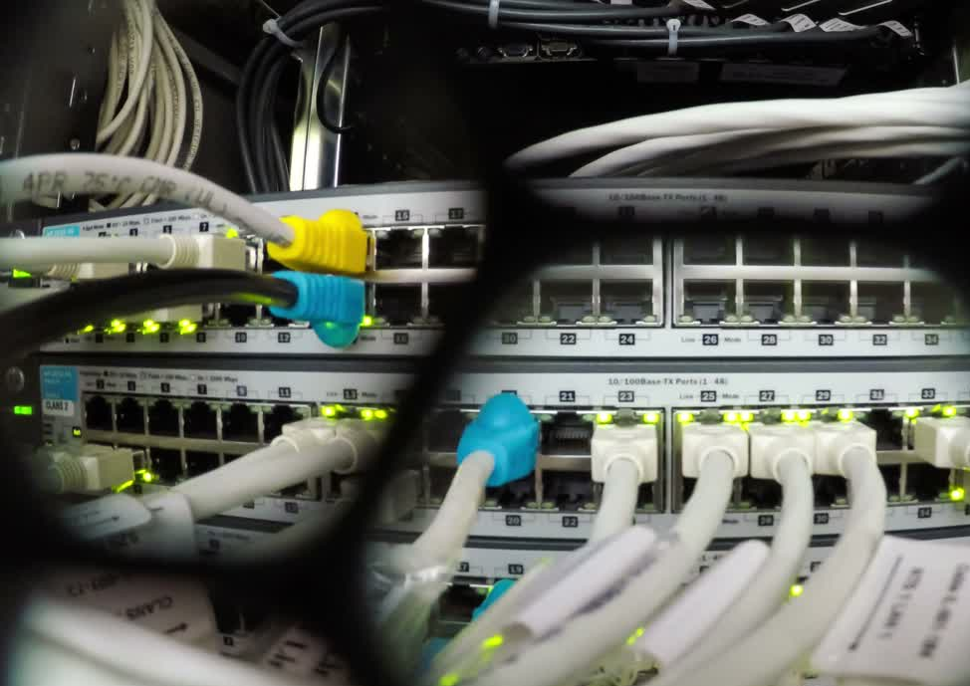
TODAY’S RAILROAD ECOSYSTEM
1
Overview
2
Lifecycle
3
Rail Specifics & Current Situation
Rail Specifics & Current Situation
4
Inherent Risks for Safety & Security
4
(c) 2024 McIndoe Risk Advisory | PROPRIETARY

Slide 5
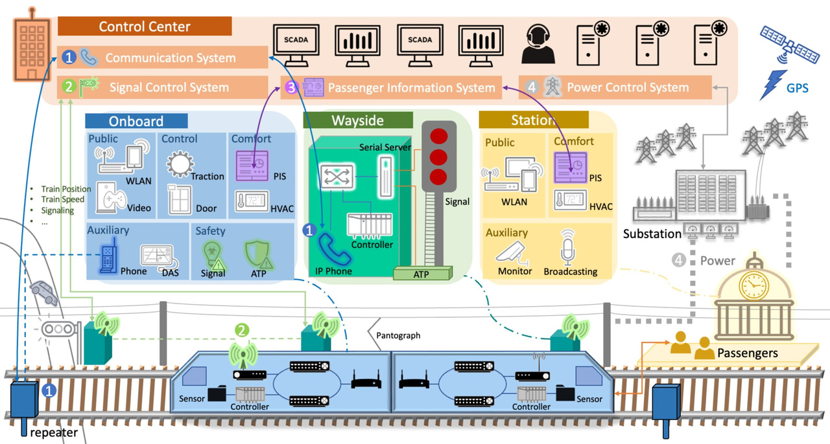
OVERVIEW OF RAIL ECOSYSTEM FUNCTION
Rail Infrastructure - Another perspective
Green: The principle wayside
functions (signaling)
Blue: The principle Onboard
Functions and its connectivity to
wayside (signaling)
Yellow: Train station functions
Orange: Control Center, Service
and Comfort
  Subsystems are often hosted by legacy equipment, often decades behind current technology, with little or no security functions. Often only physical security.
  With an overreliance on physical oversight and management.
5
(c) 2024 McIndoe Risk Advisory | PROPRIETARY

Slide 6
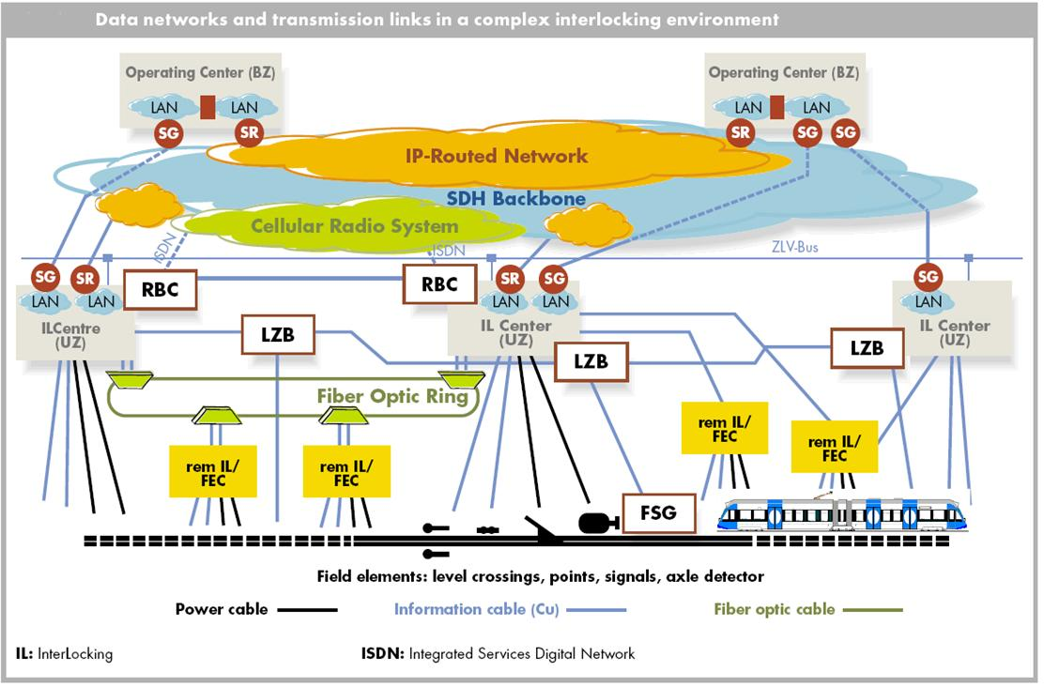
THE RAILROAD ECOSYSTEM NETWORKS
  The network view, top-down with different operational layers
  Starting with Operating Centers
  Different network-based links to safety-critical
    RBC = Radio Block Center
    LBC = Linear Train Control
    FSG = Fahrweg Sicherung (Roadway Protection)
… are the heart of the signaling
  With dedicated links to hundreds of Field Controllers and Endpoint Devices
  Finally, to trains running on track
6
(c) 2024 McIndoe Risk Advisory | PROPRIETARY

Slide 7

CYBERSECURITY IN DEPTH
1
IT Security versus OT Security
2
Confidentiality & Integrity
3
Cybersecurity Standards for OT
(IEC 62443 & CRA)
4
Rail Specifics & Current Situation
Rail Specific Standards EN TS 50701 & IEC 62345
7
(c) 2024 McIndoe Risk Advisory | PROPRIETARY

Slide 8
IT SECURITY VERSUS OT SECURITY
In the context of Cybersecurity, an important distinction should be made between IT and OT
  IT Security deals with information and data processing.
  OT Security focuses on operational technology for process control and regulation.
Creating a significant distinction in the security goals of the cybersecurity methodology to be implemented
  For the IT sector, the emphasis is primarily on protecting the data to be processed!
  For the OT sector, the focus is on ensuring the availability and integrity of an application or function.
The following is the list of Security controls used to drive the decision making process:
The Inverse CIA Approach for OT
  Availability (also under attack)
  Integrity (Static and Dynamic)
  Confidentiality
  Use Control and Permission
  Monitoring (for reaction in a timely manner)
8
(c) 2024 McIndoe Risk Advisory | PROPRIETARY

Slide 9

CYBERSECURITY STANDARDS FOR OT
  The most significant Cybersecurity Standard in the world for industrial Systems is EN IEC 62443 series, with very detailed and really useful requirements separated for:
    For System Level EN IEC 62443-3-3
    Derived from that for Devices & Controller and Networks EN IEC 62443-4-1 & IEC 62443-4-2
  In 2025, the EU will implement the Cyber Security Resilience Act (CRA), enforcing dedicated Cybersecurity functions. This follows the same guiding principles as the EN IEC 62443 series but with a clear obligation for the manufacturers of the products they create.
  This is a paradigm change from the EN IEC 62443 series, shifting the obligation for fulfilling the given Cybersecurity requirements away from the system’s Owner or Operator to the Manufacturer.
9
(c) 2024 McIndoe Risk Advisory | PROPRIETARY

Slide 10
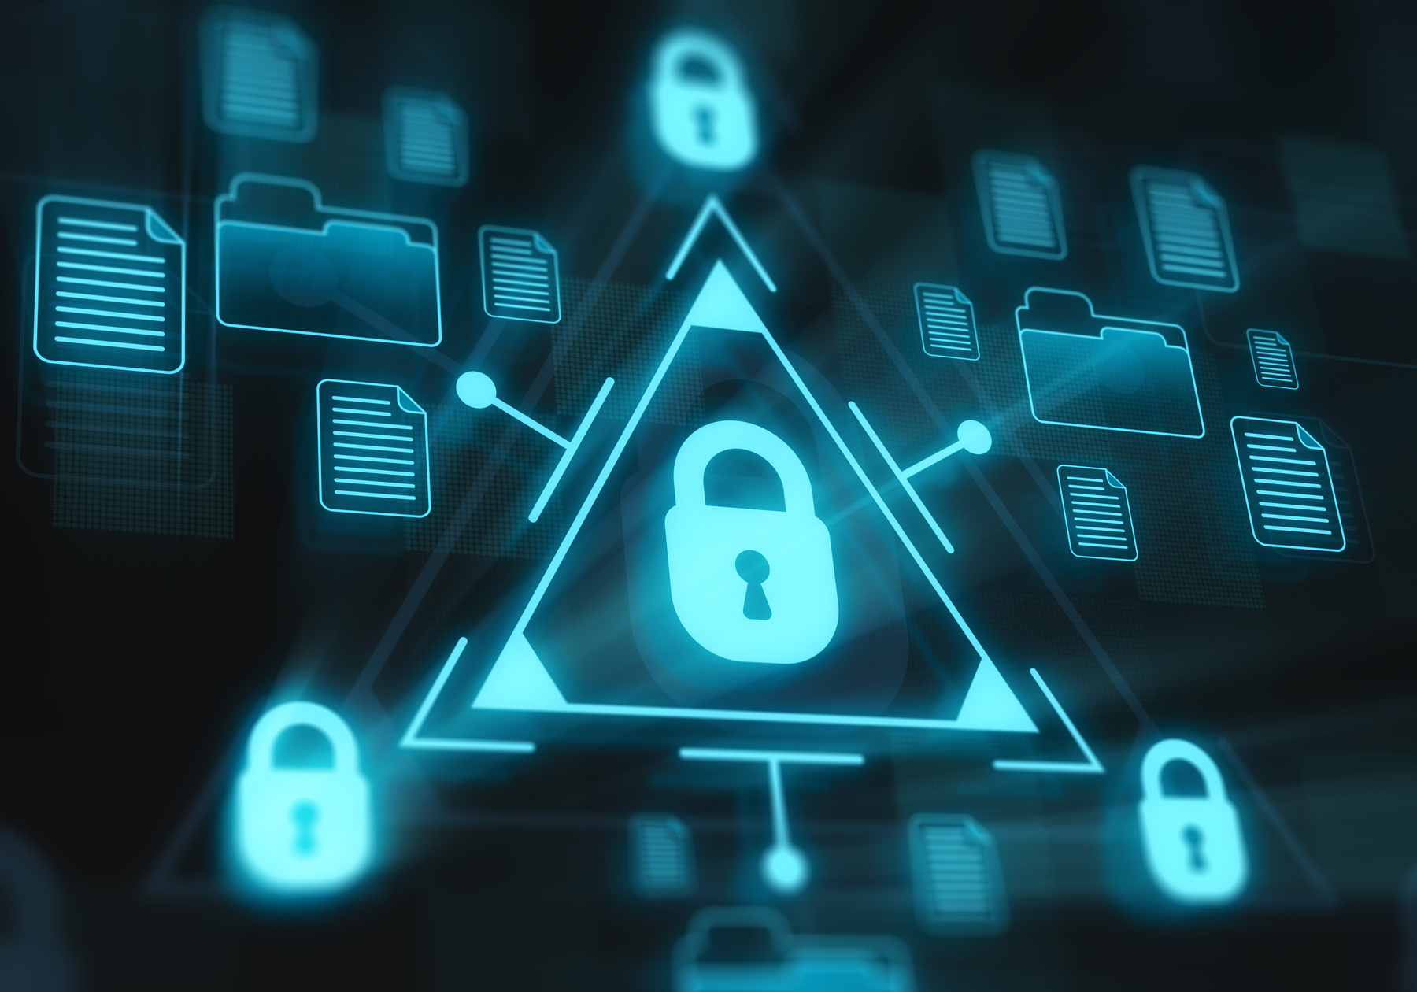
CONFIDENTIALITY AND INTEGRITY
THE MOST FUNDAMENTAL CYBERSECURITY CONTROLS ARE :
  Confidentiality of (users and subscribers)
  Integrity of the System, Controllers (HW & SW), and data (configuration data and for information)
Currently, the target of every Assessment and Qualification of a Cybersecurity framework to establish in OT, is required to provide evidence of how and which methodology is used to fulfill the Controls. The means used to implement this Assessment and Qualification consists of:
  Processes and Rules
  Access control of Users, Administrators
  Monitoring or observing detecting anomalies (reactive)
Or Implementing Security functions for resilience based on encryption, hash values, and secure storage
10
(c) 2024 McIndoe Risk Advisory | PROPRIETARY

Slide 11






CYBERSECURITY SOLUTIONS OF TODAY
Cybersecurity Management System
Network Architecture (Zoning, DMZ, Firewall)
Access Control & Permission
Monitoring Network
Encryption of Transferred Data with TLS, Certificates, and Public Key Infrastructure (PKI)
Patch Management
11
(c) 2024 McIndoe Risk Advisory | PROPRIETARY

Slide 12






CYBERSECURITY MANAGEMENT SYSTEM
Requirements
Establishing a companywide Management Methodology
Clarifying roles & responsibilities, typically held by the CISO
Enforcing employee training
Monitoring for potential vulnerabilities
Implementing a Patch-Management Process to address vulnerabilities
Conducting ongoing Risk Assessments for Risk Management
This process is human-managed and involves significant manual effort!
12
(c) 2024 McIndoe Risk Advisory | PROPRIETARY

Slide 13

MONITORING
  The next step of innovation was intelligent System Monitoring, focusing primarily on the system network.
  Sensors, similar to a firewall reading the throughrouting network traffic
  Mirroring, an additional split of the traffic on a specific router to enable or support the Monitor instance with data from that specific node.
  The Monitoring system in the background analyzes incoming traffic against the normal behavior of the system learned by training (AI based) or rules to identify anomalies. Alarms are triggered in the event an anomaly misbehavior is identified.
Unfortunately, the Monitoring Solution had to be manually managed, constantly installing Upgrades, New Versions, newly Integrated Components, new Vulnerabilities and so on.
13
(c) 2024 McIndoe Risk Advisory | PROPRIETARY

Slide 14
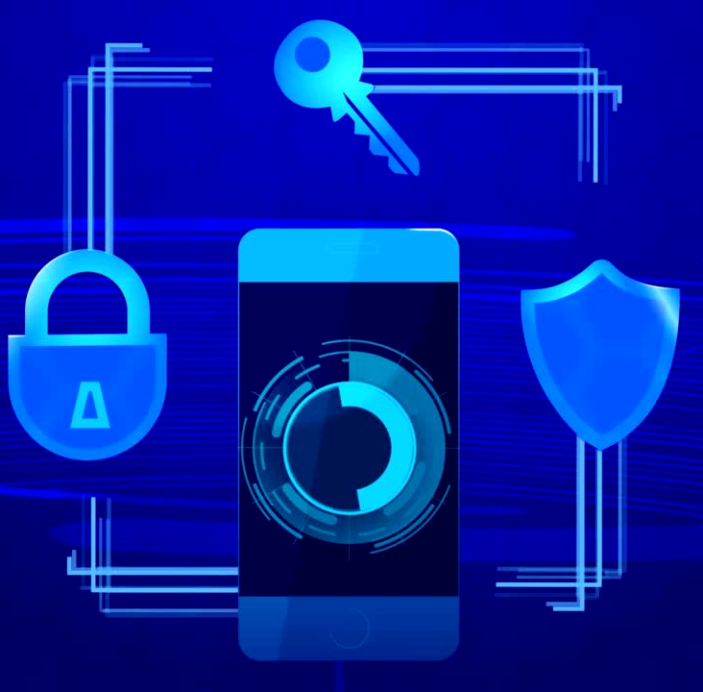
ENCRYPTION OF DATA-IN-MOTION
VIA TLS, CERTIFICATES & PKI
  The next step in Cyber Security innovation involves using encryption to protect data during transfer or at rest.
  Keys must be distributed among authorized users to secure the data.
  TLS implements encryption algorithms for secure data transmission.
  The Bulk Encryption Key (BEK) must remain secret and requires careful distribution.
  Public Key Infrastructure (PKI) generates and distributes keys using certificates.
  Certificates can be vulnerable to attacks, necessitating periodic updates and exchanges, especially after a breach or revocation by the PKI provider.
14
(c) 2024 McIndoe Risk Advisory | PROPRIETARY

Slide 15




PATCH MANAGEMENT OT AND WITHIN RAIL
Automated and secure software upload and patch management tools, like those in the automotive sector, are lacking. Current tools often use weak and outdated encryption, and distribution is typically manual, making the process costly and slow, especially for patching entire fleets or wayside controllers.
Mostly, USB sticks or similar portable mediums are used. But especially USB-Sticks or dedicated laptops are with significant risks for importing viruses, malware or unwished software into the
System.
To reduce risks, upload procedures within the Cyber Security Management System should include decontamination stations with virus scanners. Alternatively, limit USB stick usage to those marked for quarantine.
The approaches have limitations:
  Decontamination stations need regular updates.
  Zero-day exploits are excluded.
  Final software version control requires manual, local tooling.
15
(c) 2024 McIndoe Risk Advisory | PROPRIETARY

Slide 16

INHERENT CYBERSECURITY RISKS
RISK ASSESSMENT AGAINST PRINCIPLES
C.9 Assume Secrets are not Safe
C.14 Precautionary Principle
C.15 Continuous Protection
Note: These Principles are a subset of EN DIN TS 50701:2023 Appendix C
16
(c) 2024 McIndoe Risk Advisory | PROPRIETARY

Slide 17

RISK ASSESSMENT AGAINST PRINCIPLES
An intriguing question is whether real risk-reduction implementations of current Cybersecurity solutions exist in the market and what their costs are.
Is the answer measurable or quantifiable?
We recommend checking against Cybersecurity Design Principles, which we can find per example at EN TS 50701 Appendix C
The definition of attack vectors relies on assumptions about attacker behavior, but since humans aren't always rational, risk assessments may include uncertainties and be misleading.
Design Principles are abstract rules derived from lessons learned during the design process.
17
(c) 2024 McIndoe Risk Advisory | PROPRIETARY

Slide 18



C.9 ASSUME SECRETS ARE NOT SAFE
In simplistic terms, the assumption is always that it is only a matter of time before the defender and the attacker have the same knowledge.
There are no secrets per:
• The System Architecture
• Path Phrases and Passwords
• Private Keys (the base of encryption)
Resolving a detected breach after the fact, is always difficult, requiring manual intervention and remediation (controlled and implemented by experts), with all the failure capabilities of a manual process.
18
(c) 2024 McIndoe Risk Advisory | PROPRIETARY

Slide 19

C.14 PRECAUTIONARY PRINCIPLE
Make ‘The Precautionary Principle’ a key requirement for design decisions!
The Precautionary Principle supports the adoption of cybersecurity mechanisms or design principles in response to perceived threats or vulnerabilities, even without historical risk evidence or when supporting data is speculative.
Even when there is no evidence of imminent threats, but there are identified potential risks or attack scenarios, particularly (as in rail) products, with significant mitigating conditions such as:
  Long-lasting product life cycles
  Costly homologation
  High Complexity of the system
Note: See C. 14 Precautionary Principle EN DIN TS 50701
19
(c) 2024 McIndoe Risk Advisory | PROPRIETARY

Slide 20

C.19 CONTINUOUS PROTECTION
There can be no absolute assurance regarding system security provided. The only assurance is that best efforts will be made within the constraints of whatever cybersecurity methodology is capable of providing the required confidentiality, integrity, availability, and privacy protections.
Continuous Protection’ is a challenging requirement as it literally means continual protection of the system, through all phases and use cases.
From Power-On/Reset, to the Boot-Procedure, until Runtime is Active, the Continuous Protection will be in a Degraded Mode, with Limited Network access!
Example: Continuous Protection that depends upon cloud-based monitoring is instantly rendered useless if internet connectivity is broken!
20
(c) 2024 McIndoe Risk Advisory | PROPRIETARY

Slide 21

Introducing
BART SHIELDS
AKM +AIM’S SUSTAINABLE SOLUTION
FOR THE RAIL ECOSYSTEM
(c) 2024 McIndoe Risk Advisory | PROPRIETARY

Slide 22
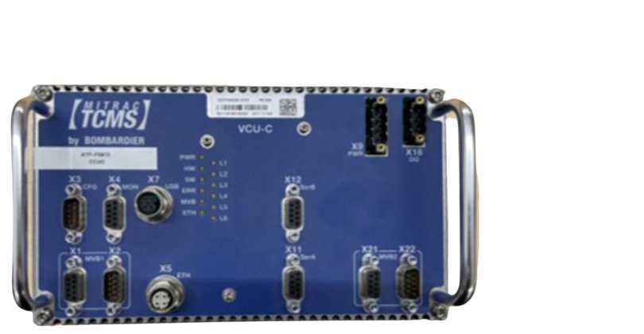
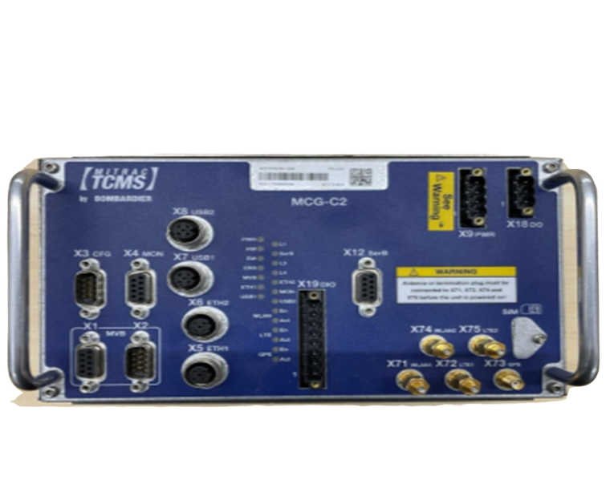
WHAT ATTRACTED KLEMENS TO AKM?
“In 2018, I met Klemens while focused on Autonomous Key Management (AKM) for rail safety and security through encryption. However, Klemens was exploring how AKM enables endpoint authentication, ensuring trusted communication amongst electronic modules in the rail ecosystem.”
MITRAC MCG
VCU - C (1)
VCU - C (2)
Identity Verification:
I am who I say I am
Identity Verification:
I am who I say I am
Identity Verification:
I am who I say I am
22
(c) 2024 McIndoe Risk Advisory | PROPRIETARY

Slide 23


STATE OF CONFIGURATION & PATCH MANAGEMENT TODAY
Alex Brush
Q: How is Configuration and Patch Management implemented today?
A: Unfortunately, through a lot of manual processing and verification!
23
(c) 2024 McIndoe Risk Advisory | PROPRIETARY

Slide 24

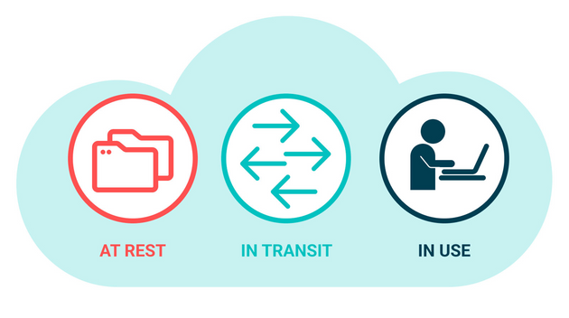
KLEMENS HAD AN IDEA!
After learning that AKM authenticated the Physical Hardware, Klemens then asked me, whether or not AKM could also authenticate executables and files and not just the physical hardware.
This answer to this question is what led to the development of what we have at our demo today, “Asset Integrity Management”, which protects both Data-at-Rest and Data-in-Use, that also uses AKM to communicate (as AKM is primarily focused on protecting Data-in-Transit).
24
(c) 2024 McIndoe Risk Advisory | PROPRIETARY

Slide 25

WHAT IS THE SOLUTION TO ADDRESSING THE ISSUES?
Autonomous Key Manager (AKM) primarily addresses confidentiality and endpoint integrity, while protecting and authenticating Data-in-Motion by organizing data/users/devices (assets) into unlimited virtual security groups, each representing a unique digital relationship. AKM is a simple drop-in replacement for today’s failing PKI + TLS standards
Asset Integrity Management (AIM) explicitly addresses the integrity of all physical (devices) and virtual (electronic images and digital twins of users, groups of devices, and entire systems). AIM protects Data-at-Rest and Data-in-Use by providing continuous system-wide authentication and monitoring security groups (systems & subsystems) of approved (Known-Trusted) AKM-enabled digital assets. Specifically designed to meet CENELEC rail standard TS 50701.
Together, AKM + AIM, can address both security and integrity simultaneously, enabling most homologation verification to be done in real-time for perpetuity.
25
(c) 2024 McIndoe Risk Advisory | PROPRIETARY

Slide 26

FROM OUTSIDE TO INSIDE - A PARADIGM SHIFT
In contrast to most existing Solutions and Approaches, the AKM+AIM approach inherently offers cybersecurity as part of the System to secure cybersecurity resilience from the Inside!
AKM+AIM offers a unique network security solution that focuses on core requirements like confidentiality (encryption) and integrity (authentication) rather than adding complexity and costs.
Anomalies, manipulation, or corrupted SW or HW within a system, are evaluated, identified, and isolated during system Power-On/Reset and during Runtime.
AKM+AIM are based on strong encryption (confidentiality), endpoint authentication (data-at-rest), active executables (data-in-use), and authenticated communication (data-in-motion). AKM+AIM provides true, multipoint-to-multipoint, end-to-end encryption + authentication, resulting in true Zero Trust Authentication.
Secure the Integrity of the Components (HW +SW) on every layer, starting with the boot process, instantiation of the Operating System, then to the Application Layer, and finally, the Configuration of hosts, and Associated Controllers.
26
(c) 2024 McIndoe Risk Advisory | PROPRIETARY

Slide 27

VISIT AKM’S BOOTH FOR
DEMO
“ASSET INTEGRITY MANAGEMENT”
Protects both Data-at-Rest and Data-in-Use and
uses AKM to communicate Data-in-Transit securely
(c) 2024 McIndoe Risk Advisory | PROPRIETARY

Slide 28


(c) 2024 McIndoe Risk Advisory | PROPRIETARY

Slide 29
Thankyou
(c) 2024 McIndoe Risk Advisory | PROPRIETARY

