Slide 1
Hack the Railroad - 2024
FRA Cybersecurity Update
Railroad Operational Technology
October 23, 2024

Slide 2
Agencies Contributing to Critical Infrastructure Resiliency
White House
National Cybersecurity Director
Department of Defense and the National Security Agency
Military and Intelligence Operations
Department of Justice
Law Enforcement
Department of Homeland Security
Coordinates sharing of threat information, secures critical infrastructure
Sector Specific
Agencies
Protect Critical Infrastructure
DOT
FBI
FRA
CISA
TSA
USCG

Slide 3
USDOT ‘s Strategic Priority is to make our Transportation Systems Safer
The National Cybersecurity Strategy, released in March 2023, includes Defending Critical Infrastructure as one of its four (4) pillars
This Strategy recognizes that robust collaboration, particularly between the public and private sectors, is essential to securing cyberspace
The Department of Transportation, as a Co Sector Risk Management Agency for transportation, will support the Strategy’s implementation to help protect transportation critical infrastructure
In supporting the Strategy’s implementation, we work closely with our Co Sector Risk Management Agency partners at the Transportation Security Administration (or TSA) and the US Coast Guard
The Department houses the new Office of Sector Cyber Coordination to lead a ‘One DOT’ strategy to enhance US transportation sector cybersecurity and engage with stakeholder communities across the sector

Slide 4
FRA regulates Freight Rail, Intercity Passenger Rail (Amtrak) and Commuter Rail
FRA’s Mission is to Enable the Safe, Reliable and Efficient Movement of
People and Goods for a strong America, now and in the future.
FRA accomplishes its mission primarily through:
Issuance, implementation and enforcement of safety regulations
Managing Federal investments in freight and passenger rail across the country
Research and technology development
Today, FRA regulates approximately 800 railroads
Regulatory Design, installation and maintenance requirements and FRA approvals process, to ensure safety and security (including cyber risks)
Cyber security resilience requirements for FRA grants
Cyber security related research

Slide 5
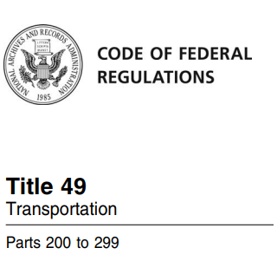
FRA’s Cybersecurity focus reflects the ever-increasing complexity of OT
Innovative Developments overlayed on Legacy Systems:
Integrated Locomotive Cab Environment
  Engine Control and Distributed Power
  Energy Management
  Positive Train Control
Next Generation Centralized Monitoring & Control
  Dispatch Systems
  SCADA
  PTC Back-Office
  Remote Monitoring
  AI supported Advisory Systems
Safety and Security are fully intertwined
Part 218: 131 – 137 Risk Assessment relating to crew size
Part 229 Subpart E – Locomotive Electrics
Part 236 Subpart H – Microprocessor Based Control Systems
Part 236 Subpart I – Positive Train Control
Part 238: Subpart G - Safety planning requirements (Tier II)
Part 238: Subpart H – Tier III (coming soon)

Slide 6
Recent USDOT & FRA Collaborative Efforts relating to Cybersecurity
USDOT & FRA are supporting DHS in Railroad Cyber Security Efforts:
Rail Working Group
TSA Security Directives & Regulatory Developments
Subject Matter Expertise to support Vulnerability Analysis and Sector Risk Assessments
Project CHARIOT
FRA is part of DOT’s Positioning Navigation Timing Efforts:
Executive Order 13905 – Strengthening National Resilience through Responsible Use of Positioning, Navigation, and Timing Services

Slide 7
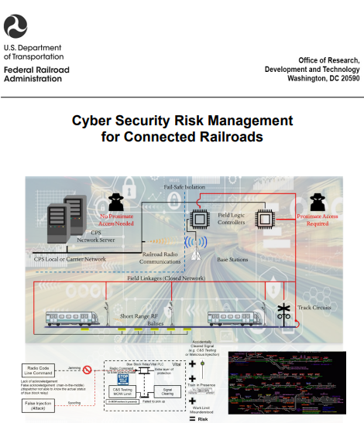

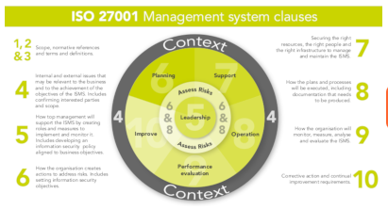
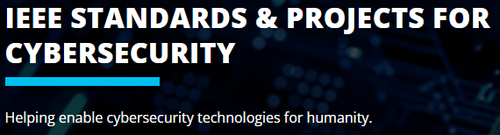
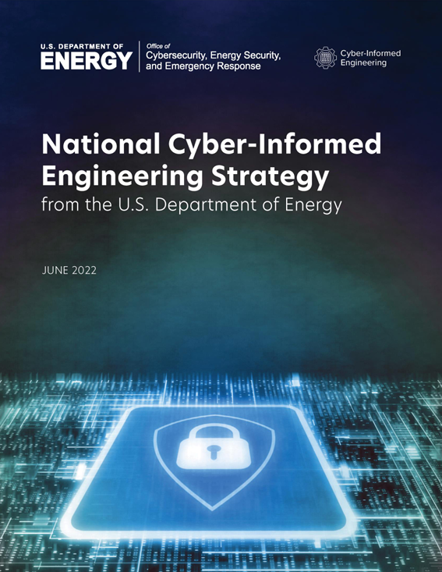
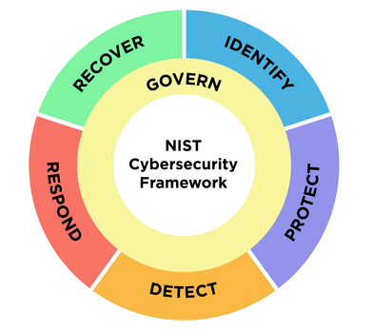
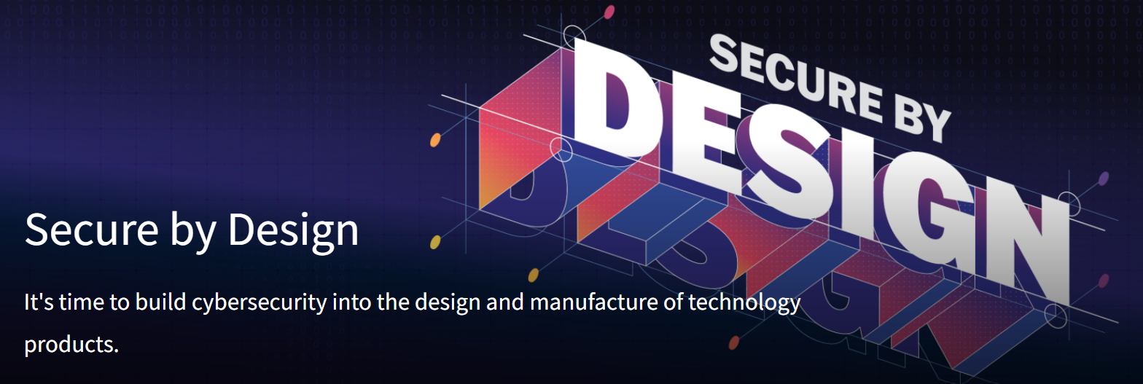
FRA’s Cyber Focus Over the Last Year: Standards, Best Practice and Regulations
Evaluate Standards & Best Practice
Design
Operations & Maintenance
Technology Migration
Stakeholder Engagement:
Government
Railroads
Supply Industry
International Community
Regulatory Review:
New and Novel Technology
System Safety and Risk Reduction
Integrated Systems of Systems

Slide 8
We must address cyber risk at the product, subsystem, system and operational level
Secure by Design ¹
  Products are built in a way that reasonably protects against malicious cyber actors successfully gaining access to devices, data, and connected infrastructure
  Secure by Default
Cyber-Informed Engineering ²
  Cyber-Informed Engineering (CIE) is an emerging method to integrate cybersecurity considerations into the conception, design, development, and operation of any physical system, energy or otherwise, to mitigate or even eliminate avenues for cyber-enabled attacks.
  CIE concepts use design decisions and engineering controls to prioritize defense against the worst possible consequences of cyberattacks facing critical infrastructure systems and asset owners
The Challenge:
Innovative Developments
overlayed upon
Legacy Systems … who is responsible?
Integrated Locomotive Cab Environment
  Engine Control and Distributed Power
  Energy Management
  Positive Train Control
Next Generation Centralized Monitoring & Control
  Dispatch Systems
  SCADA
  PTC Back-Office
  Remote Monitoring
  AI supported Advisory Systems
¹ https://www.cisa.gov/securebydesign
² Cyber-Informed Engineering | Department of Energy

Slide 9
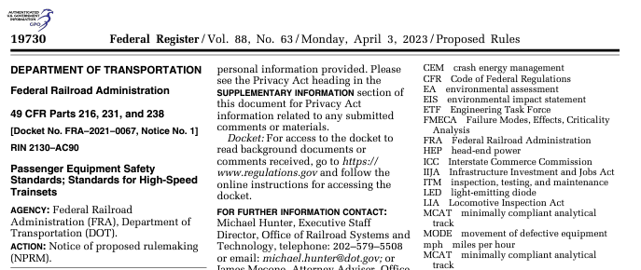
2023 Notice of Proposed Rulemaking: Passenger Equipment Safety Standards
Among other things, this update to 49 CFR Part 238 completes the requirements for High-Speed Trainsets
As published in 2023, included the requirements for a Vehicle Control System and Communications Vulnerability Assessment
  Identify system vulnerabilities and associated risks
  Apply countermeasures
  Risk mitigations
The final rule will reflect public comments and recent developments by DHS and other agencies to mitigate cyber security risks

Slide 10

Takeaways
Operational Technology that supports critical infrastructure is hackable – threat continue to target OT
Be vigilant: Phishing works – still common, still effective
We are thinking about what all of this means for FRA and our equities in a regulatory space
Watch this space as we apply what we have learned to current rulemakings

Slide 11
Carolyn Hayward-Williams
Director, Office of Railroad Systems and Technology
Office of Railroad Safety
Federal Railroad Administration
202-493-6036
c.hayward-Williams@dot.gov
Jen Gallagher
Program Analyst | Cyber
Office of Railroad Systems and Technology
Office of Railroad Safety
Federal Railroad Administration
202-878-2691
jennifer.gallagher@dot.gov

