Slide 1


From SOC to OCC -
How Wide is the Gap?
Yaniv Mallet
Field CTO
OCT 24, 2024

Slide 2
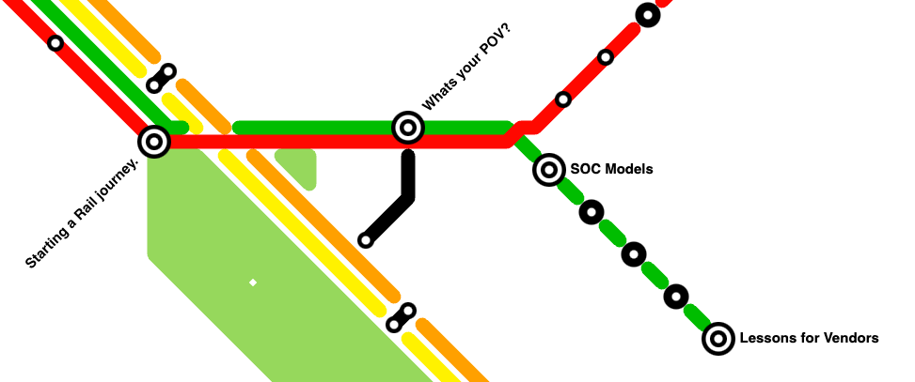
Agenda
Notes:
Greetings – pleasure to be here for the 3d time, such a special conference. Last times I was in the other room, this year I have the chance to be here and got the nice spot after lunch.
**open by what is OCC. to be sure US audience is on the same page *
Although the name of this ppt, I want to talk about the cyber2rail integration in general. SOC and OCC are only the tip of the spear and the most time-sensitive ones, but we need to look at that from the perspective of the whole industry.
As a lot of things in life, a major part of communication improvement is around understanding the POV of each side. On one side we have a long and rich culture of rail operations, with years of experience about how to do things and how to collaborate between the different teams. On the other hand, we have cyber people, that comes from a younger industry (sometimes maybe also younger generations of people?), and they got a lot of tools of their own, communities around the world that share information and knowledge. Plus supporting agencies/orgs that provides them with frameworks and best practices.
How are they going along and how can we help them?
In the next minutes I will share my findings on this topic, from my work at Cylus and a lot of discussions with clients and industry professionals from both sides of the story.

Slide 3

Getting into the Rail Business
Notes:
Let me start with my own journey…(That is also the place where I introduce myself :)
My name is Yaniv Mallet, I work at Cylus for the last 3 years and I am part of the CTO’s team.
I joined Cylus after some nice years in the cyber and cybersecurity field, almost 25 years for the government, gathering background in hardware, software, radio frequency, system engineering and an academic computer engineering education.
[I remember Justin last year talking about military and cyber…]
One of the things I was sure about, was my resilience to ACRONYMS. I was in the military, a real jungle for acronyms. Before stepping out, I learned the “civilian” cyber security jargon. At this point I was like, “OK, I am able to talk with people explaining “yes, I have a Also, and I am experienced in SIEM implantation in SOC with BCP process and with keeping up GDPR. Also can I have a sandwich of XDR with a bit of DLP on the top and some IDS on the side”. No troubles from now.
Then I got into the rail industry, tried to learn as much as possible from people and documentation and was overwhelmed by the quantity of new acronyms. Like the first document I opened was all AVLS, PIS, DMI, T2G so I opened another document and this one was like CBTC, ETCS, ERTMS, PTC. So I tried the “network protocols” and I found things like SAHARA, FIP, MVB, TRDP….
OK, so I guessed there is a lot of learning to do in order to start working here.

Slide 4
Protecting Rail Systems
Based on CLC/TS 50701
Notes:
But It’s not only acronyms, the rail industry has a vast range of different systems, from SIG, to onboard equipment, but also systems in stations and all the other supporting services. This is not like getting into cybersecurity for some industry that has SAAS apps and servers, we are dealing here with complex systems but also very different systems and technologies.
That is a lot professional fields to understand if you want to be good at protecting them.
So you hire someone to manage cybersecurity, he maybe has some experience in OT or you send him/her to ICS security course. Armed with all the Purdue model theory and some OT all airgap evangelists manifests he/she will now have to understand what challenges our Rail OT have.
I saw some examples during my work on greenfield projects and at brownfield operators. Let me give you an easy one.
POINT HEATER!
One project had an operational network required to be closed. All the efforts at design were around SIG and RSK, closing them with special tricks. At integrations I discovered that the AFC system provider, delivered special tablets for fare enforcement staff. OK, how does that work? Connecting wirelessly through the train’s wifi? No, not possible, we worked on that no wireless access will be onboard, only a separated wifi for passengers. So what have you thought of ? Nothing, you just a system provider and wait for the project company and the o&m to give you options…So take a cellular sim, and request a dedicated APN on the same provider that we use for MCPTT (explain). Months after, they understand that on the tablet, they have to use an additional saas app that the local regulator orders. Also they finally answered to the hardening questionnaire we sent them about the tablets.
So now we have 300 unknown chinese mini tablets, with wifi, bt and cellular, that want to be connected to the internal OT network from an external interface we have with a cellular provider, but also wants to be connected to the internet at the same time? Well…Can we open the line without AFC or fare enforcement? no. Can we tell the state we cannot use their system? No..Can the Purdue model understand this riddle? Interrupt!
For how we managed that? Come for a beer
This is really an easy example, “simple” IT troubles, no real ot or safety….But a preview of all the different fields one has to understand to protect a rail operator.

Slide 5
What’s your POV?
Notes:
So my short story here is not about myself, but about any cybersecurity professional that starts in the rail industry. From the CISO that gets on board to the hands-on engineer.
It requires a major learning effort, if you want to be good at it of course.

Slide 6
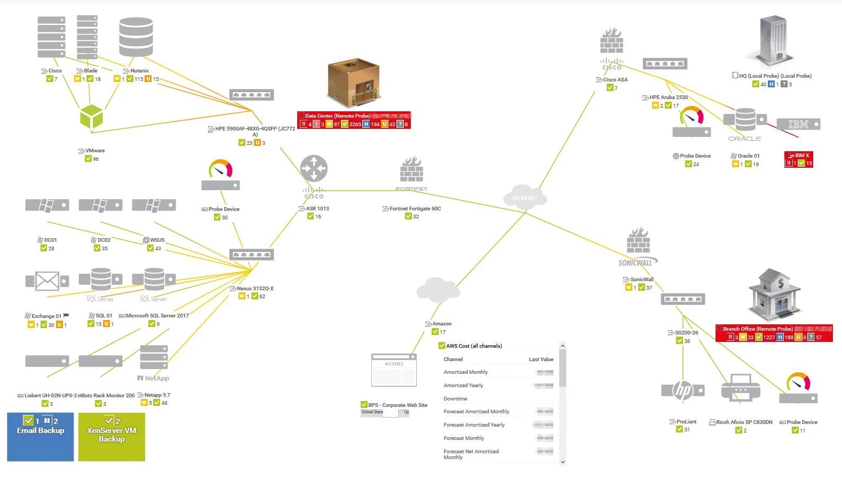
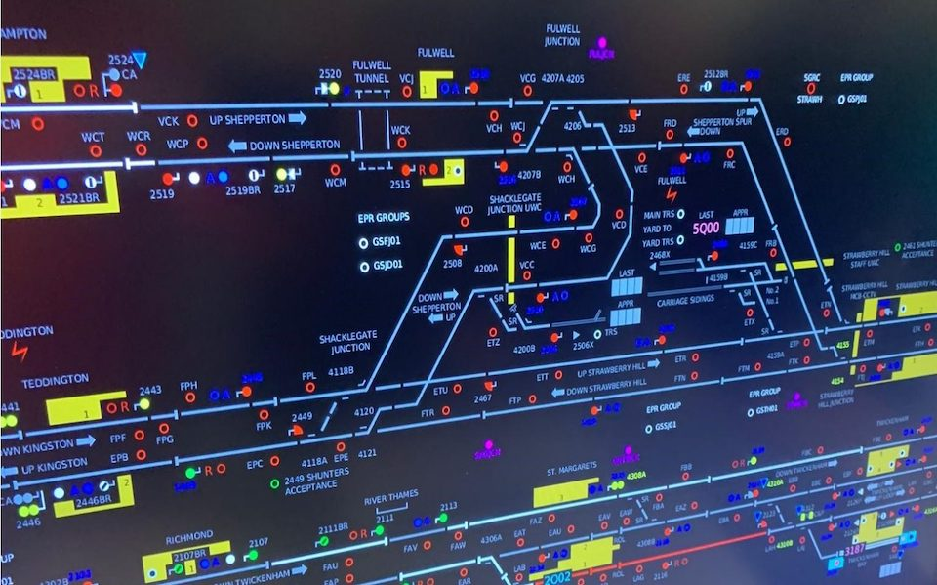
What’s Your POV?
Question: “How does your network look?”
Notes:
Now let’s look about more intimate challenges after one has a SOC next to the OCC.
We must understand that rail people and cyber people come with different backgrounds.
That also means that their POVs are sometimes very different => this can be gap in their communication capabilities.
If you ask both, how they visualize their network in their mind, cyber people will tell you about a nice VISIO diagrams, with servers, with switches, VLANs, and DR sites.
Rail people, will tell you about the train lines, their depots and terminal stations, and what kind of signaling technology they use at each segment.

Slide 7
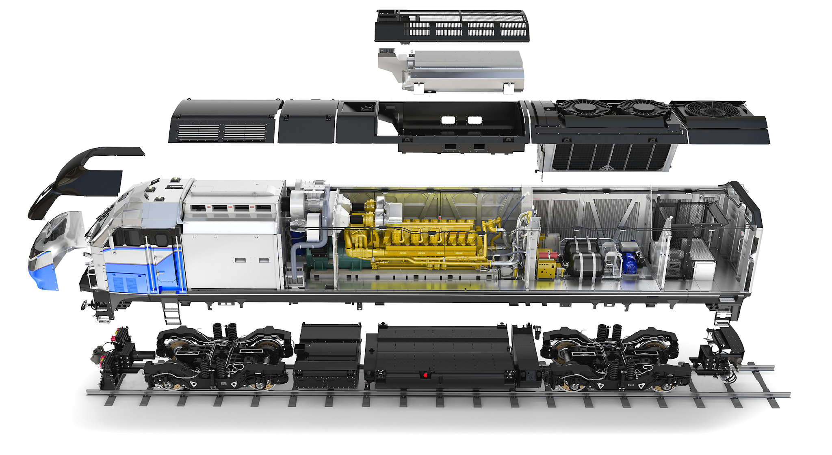
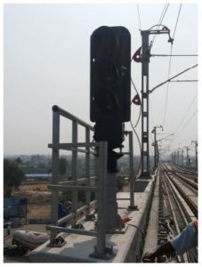
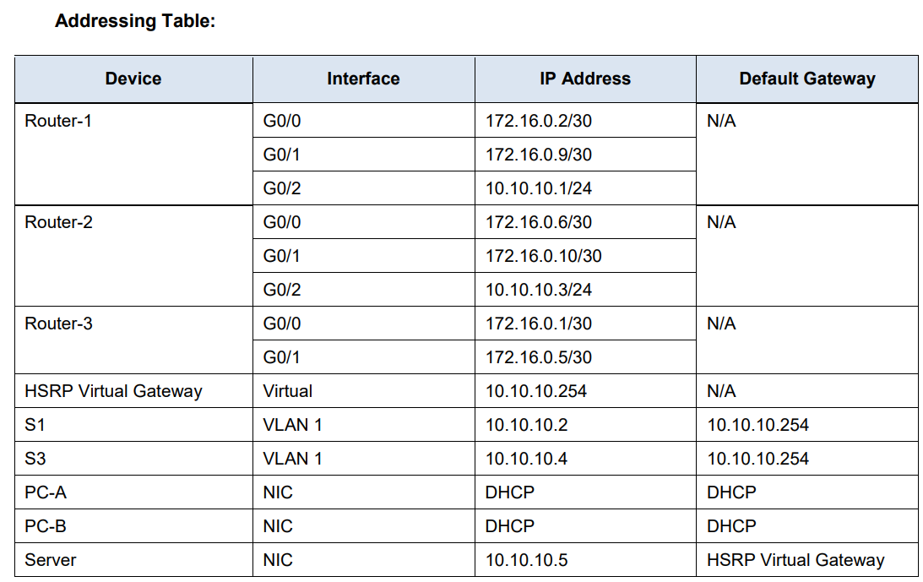
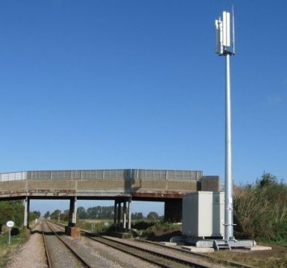
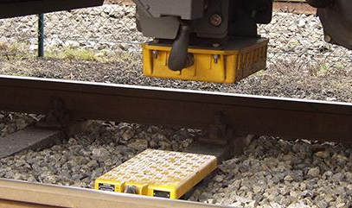
What’s Your POV?
Question: “What assets do you have?”
Notes:
If you ask both, what asset do they have in the network
The cyber people will think about IP addresses and if the device is part of the AD or not.
Rail people will think about asset types (IXL, CBTC system, AFC….) and who is the vendor that can provide advanced technical support for them.
Surely, there are some places where the culture is different and we will find a real rail knowledge in all the cyber dpt, but in general, and specially at the beginning or for a tier1 SOC operator, this is an approach we will see a lot.

Slide 8
SOC Models
Notes:
From here, I want to jump on to an organisation factor that has a lot of influence to this SOC-OCC relationship.
If you have been at some CISO or CISSP classes, we talked about people, now let’s talk about the process, then we’ll have a word about technology.
I want to talk about the different setups we saw around.

Slide 9
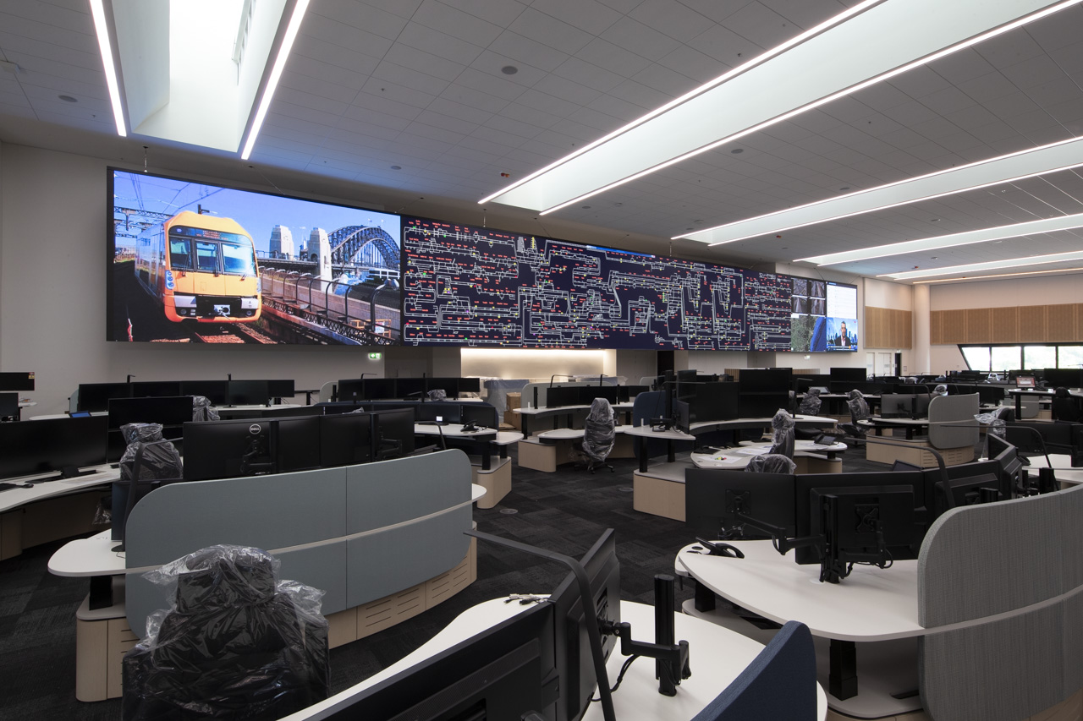
SOC Models: a Desk in the OCC
Picture Source: https://digitalplacesolutions.com/
Notes:
I want first to emphasize again that SOC is only one facet. We see a lot of operators where the cyber dpt. is not always free of action. I can tell that all of them have issues with short staff. A lot of them are struggling with their authority and responsibilities inside the organisation. We saw places where all the cybersecurity were outsourced besides a CISO that managed the outsourcing. Makes it very complicated to be in details for OT, and leaves them “only with IT”. But we also met some operators with high end ressources, and even inhouse OT pentester for OT only!
Back to SOCs:
One of our clients in EMEA started by inserting a SOC in their brand new OCC (greenline). It was a desk, next to the physical security desk (police liaison)
They faced some challenges:
“physical” focus problems -
it requires to be a separated SOC from the “other SOC” in the company, only for OT. Because of real estate
All those started to create issues with the manpower (SOC operators) and at the end they moved the SOC to a dedicated room.
During this time, people made personal connections, but due to the level of work at the beginning of the line operations, no real “mutual playbooks” were created.

Slide 10
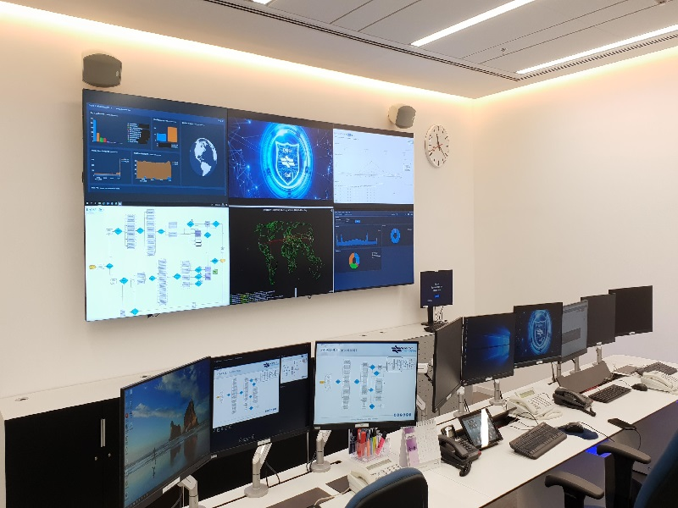
SOC Models: a Dedicated Rail SOC
Picture Source: gov.il
Notes:
Another model we saw, was to have a SOC only for the rail security. (Maybe say a word about this picture source? It is a real example).
Sounds like the best approach? I mean, let’s have people focus only on rail systems, what could be better to promote rail cybersecurity?
After some time they were challenged with manpower qtty, that was because it was quite hard to budget (and recruit) two shifts of C-SOC.
From the process POV, they had two bridges to manage: one with the “main” soc (that is overseeing all the network infrastructure) but also with the it occ itself.
They decided to go to the next option after having too many troubles at managing two SOCs
# if vibes: push here fun fact about the MOT SOC of SOCs

Slide 11
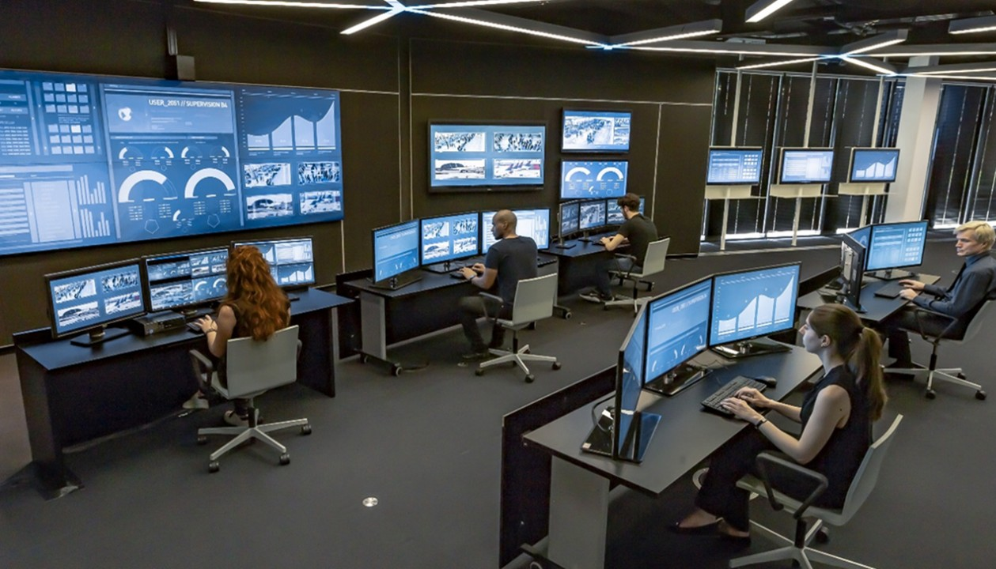
SOC Models: Full-Scale SOC
Picture Source: Polaris Market Research
Notes:
The classic but not intuitive - merge the already existing SOC of the organization (IT, public website…) with an OT desk.
Insights:
Ease on the manpower management
complicates the OT and Rail professional learning curve, but can be a way to set an attractive professional evolution for SOC operators (start with IT, continue with OT. Come with IT, learn OT with us….)
Still requires to work on the OCC relationship

Slide 12
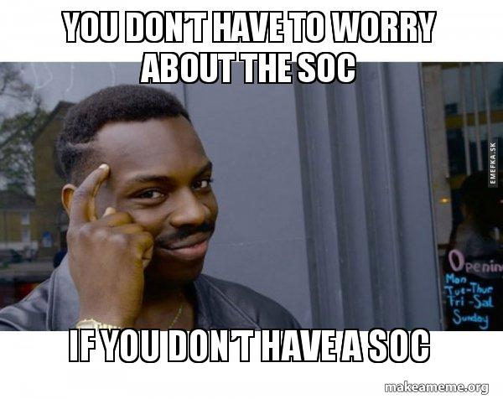
SOC Models: Before Maturity
Notes:
And sure, there is also another model – the operator doesn’t have a SOC.
Joke aside, let say that if we talk about OT SOC, this meme is indeed relevant. I don’t think I saw an operator without an “IT SOC”, but indeed there are some places that are still early in the OT security journey, and even if they have a cyber dpt, they don’t
Here, we see how the outsourcing option is on the table for a lot of operators.

Slide 13
Challenges Summary
Language and POV
Tools
Heritage
Manpower (resource in general…)
Company’s maturity
Notes:
A summary of the different challenges we saw between the cyber and operation tribes inside the operator (slide before I show some use cases from Cylus)
Language and POV: we saw how we have differences here between both sides. Personally, I believe this is the duty of the cyber side to be the one adapting and learning what is the right way to exchange and gather information with rail operations teams.
Tools: there are a lot of tools (mainly SW today) around the operator. In fact, we see that in a multi-vendor environment (which is the case of most of rail networks), we will find vendor tools for control and management. Not all the teams uses or have access to the different tools, creating some other gaps in the capability to have the full picture in hands
Heritage: rail operations has centuries (?) of experience and lessons learned. Cybersecurity has also multiple
Manpower: we are all aware of the manpower shortage headlines all around the world. When it comes to setting up and running your own SOC, this is when we face this shortage. It is complex to recruit SOC operators (any tier!), and not less complex to find people with previous experience. Now try to find someone who has experience in rail cybersecurity….Very complex.
Maturity: in the dilemma between using outsource SOC or not having an OT SOC at all.

Slide 14
Vendor’s POV
Notes:
Another (last?) piece of the puzzle: vendors….

Slide 15
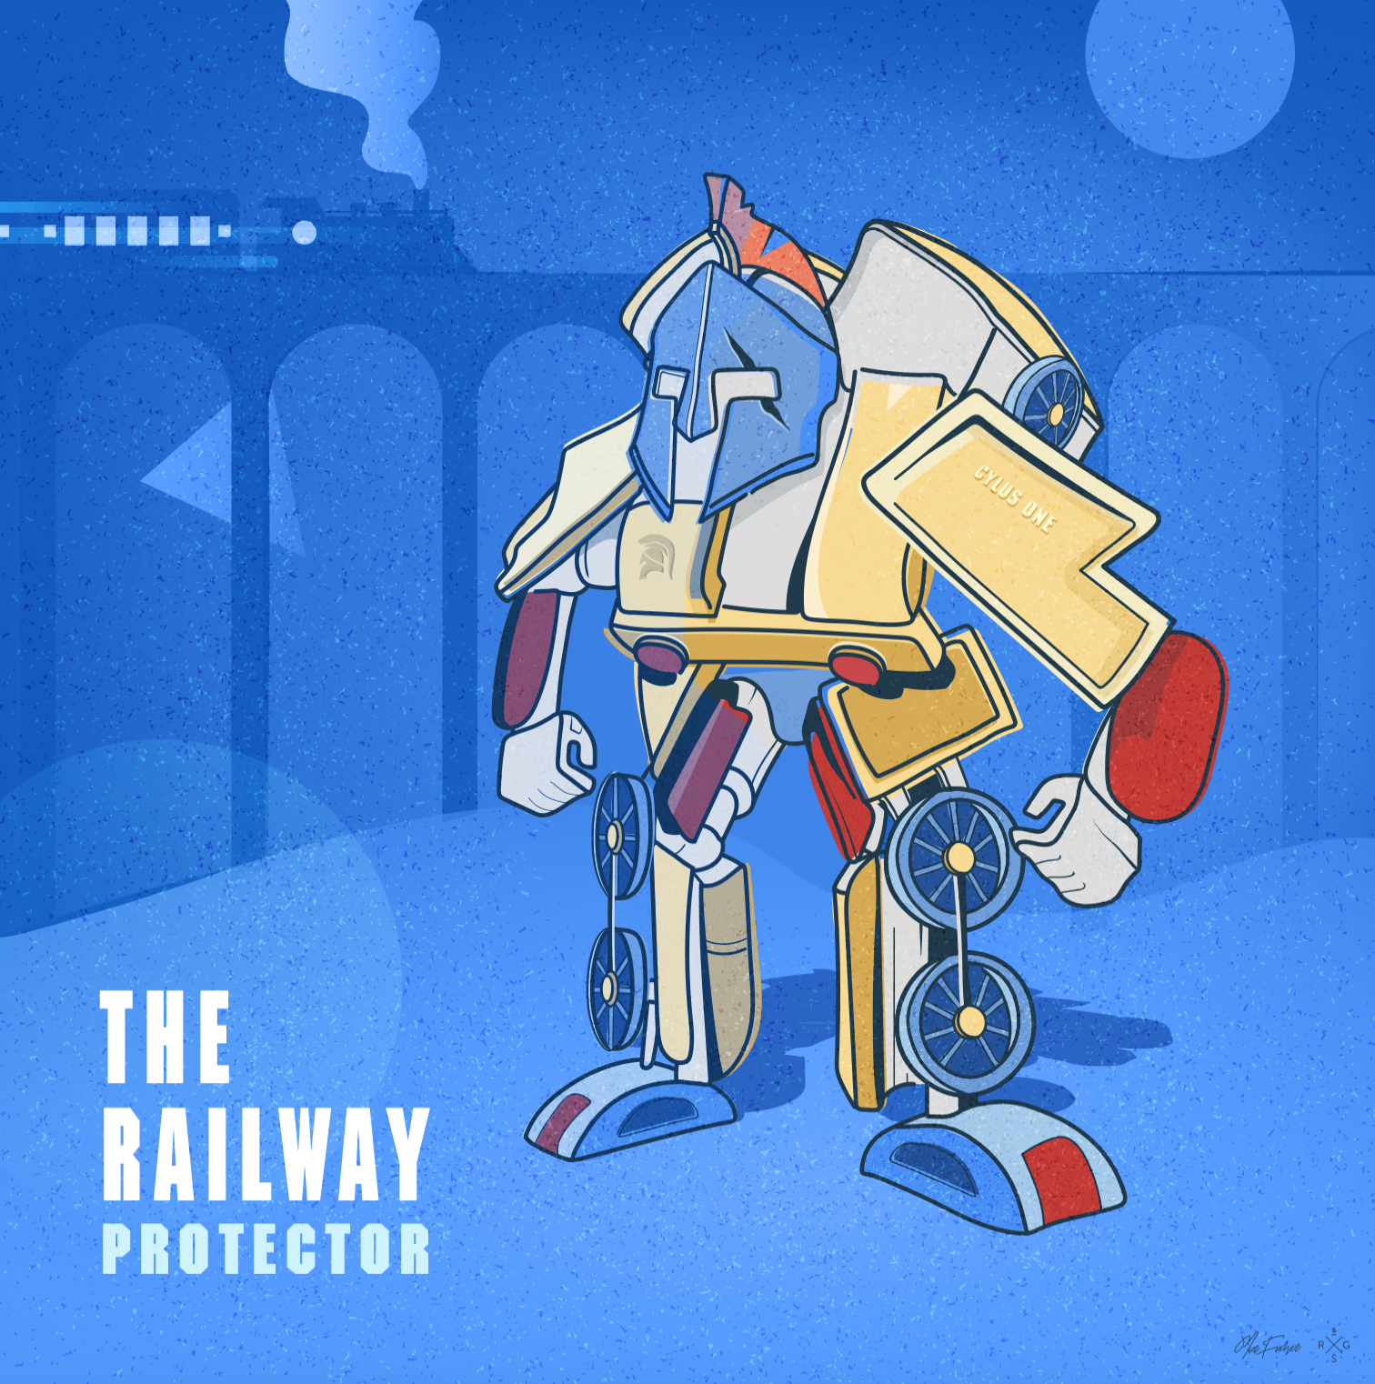
The Vendor’s POV
Notes:
Vendors are coming in the picture with a lot of influence on the industry. Sure, we all coming in with all our strength and think we are going to change the market with our product. But the market has needs…
When a vendor like Cylus is approaching the market, it has the opportunity to invest efforts in bringing both sides together.
###Sure, maybe we’ll need to ask ourselves:
Should we invest in this topic? We have a lot of features to develop to be attractive product (cyber) and to be competitive…Is this the first thing to develop?
What can we even do? We don’t have real influence about how our clients work..
Is it our place to educate?
We (Cylus) are always looking for insights to improve or change our product’s features, when we believe it will help in this matter.
There is no point in selling a product that is railway oriented only, if we are not addressing the rail industry needs. Those needs include the goal to protect from cyber attacks, not only detecting them.
I want to take few minutes to look at how a product like ours can support the cyber process and also bridge a bit of the gap we’ve been talking about.

Slide 16
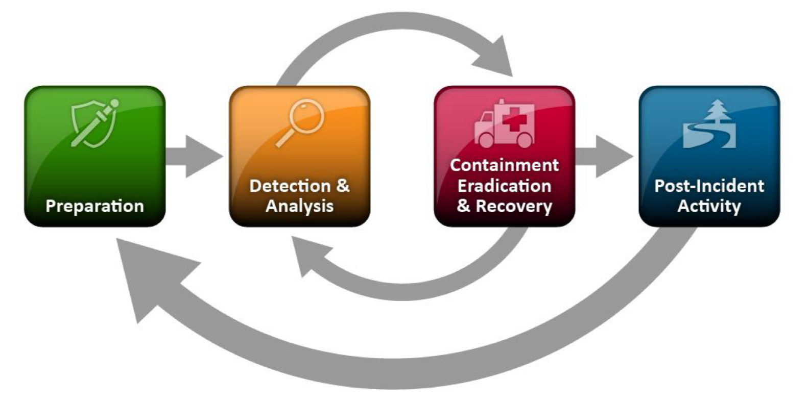
Rail Cybersecurity Solution to Support Incident Response
Notes:
This is NIST’s classical incident response sequence. CISA uses pretty much the same where they separated the red part in two and they added a collaboration phase.
When we look at this sequence, and with all the previous slides in mind, we should expect our rail cybersecurity solutions to support the different phases. I believe vendor’s development should support this sequence and add relevant features to solve customers’ and industry’s gaps.
Let’s take a deeper look.
For this ppt, I will skip the “preparation” part (that is also relevant to our topic but really defers based on the product type), and I will jump directly to the realtime incident response part.

Slide 17
Incident Response Sequence
Detection
Enrichment
Investigation
Response
Notes:
Detection of a cybersecurity incident in the railway operational network=> The cyber part…A monitoring solution shall detect attacks in time and attach to the alert event TTP that explains it. I would call it “the cyber why”. This information is the basic level required for communication inside the cyber team, or to consult with external teams (IR). If you can attach that to some known framework (like MITRE ICS), it’s even better.
Enrich the information about the alert (PCAP) and the operational context of the affected assets and network => Now we can enrich the detection event with cyber context and also rail context. Information about the involved assets in the event: assets properties (what is it, which OS, what zone it is in the zones and conduit, and such like the PCAP. But also add intimate properties that are understood from rail protocols and rail context: what system the assets are part of, who is in charge of this asset, is it a critical asset for operations and/or safety, what is the location of this asset…
Investigation: Examine historical data and check if similar events (by type, time of the day or involved assets) happened in the past. Depending on the sensitivity of the alert type, this part can be done during the reach out to Operations, or before to gather even more context and reliability.
Transfer the event following the investigation to the Operations/Maintenance teams for response activities. Following the response by the Ops/Maintenance teams, the event should be resolved via the SOC

Slide 18
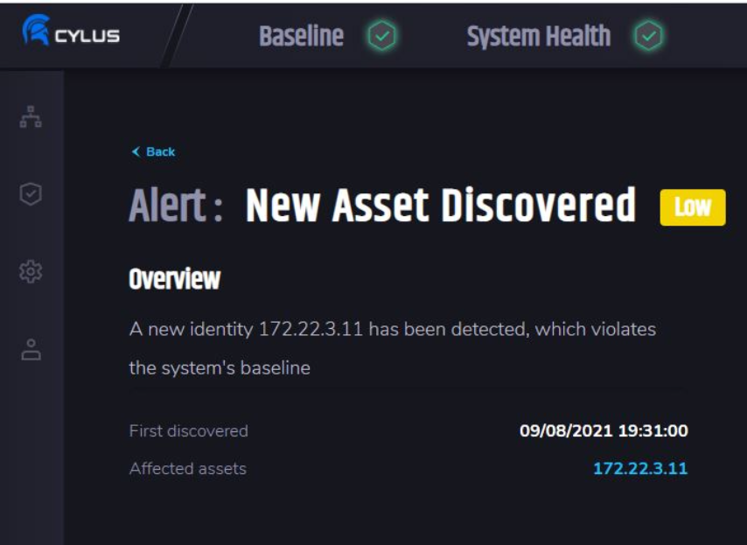
Simple example
Notes:
Let’s explore the “response” phase with an easy example. (Promise to have only two slides with our product…)
SOC operator got a “new asset discovered” in CylusOne.
If the information is only the IP like here on screen, it’s not enough to get to anything.
What the cyber solution should bring here can be the next (won’t show Cylus although for sure we do that).
TTP: new asset in a closed network (refer to possible MITRE ttp: initial acces: ROGUE MASTER in ICS matrix, or HARDWARE ADDITION in Enterprise matrix). Easy to explain why this is an alert.
Enrichement: the ip address, the mac, what he did (protocols, talked with?…’)
Enrichement2: details on the asset, its type, its vendor, the station or location where connects
History on typical assets?
Now, that could be a rogue device, but that could also be a maintenance team using (with or without following policies) some testing equipment.
With all this information, the soc operator can turn to a relevant contact:
The occ shift that will require precise information (the where maybe)
A specific occ desk if playbooks were prepared and enrichment has quality (signalling asset? Go to sig desk. Cctv asset? Go to security desk…)
Directly to a maintenance team based on the history of similar assets.
Based on this check, the next steps are highly different:
we have a rogue asset that must be quarantined and analyzed (IR event starting), this is maybe the last time to catch a new attacker.
or we just need to revalidate the work policies with the teams and suppliers. Who can connect? How? Is someone checking the laptop they bring?
This is a basic example, now think about how intimate it gets if we talking about the detection of a new balise on tracks, or a new base station (AP) that assets are talking with….

Slide 19
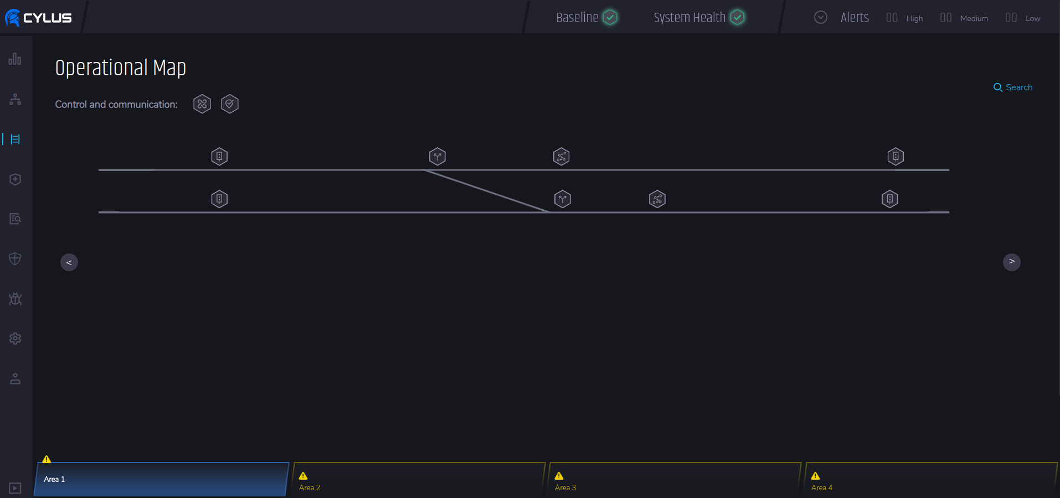
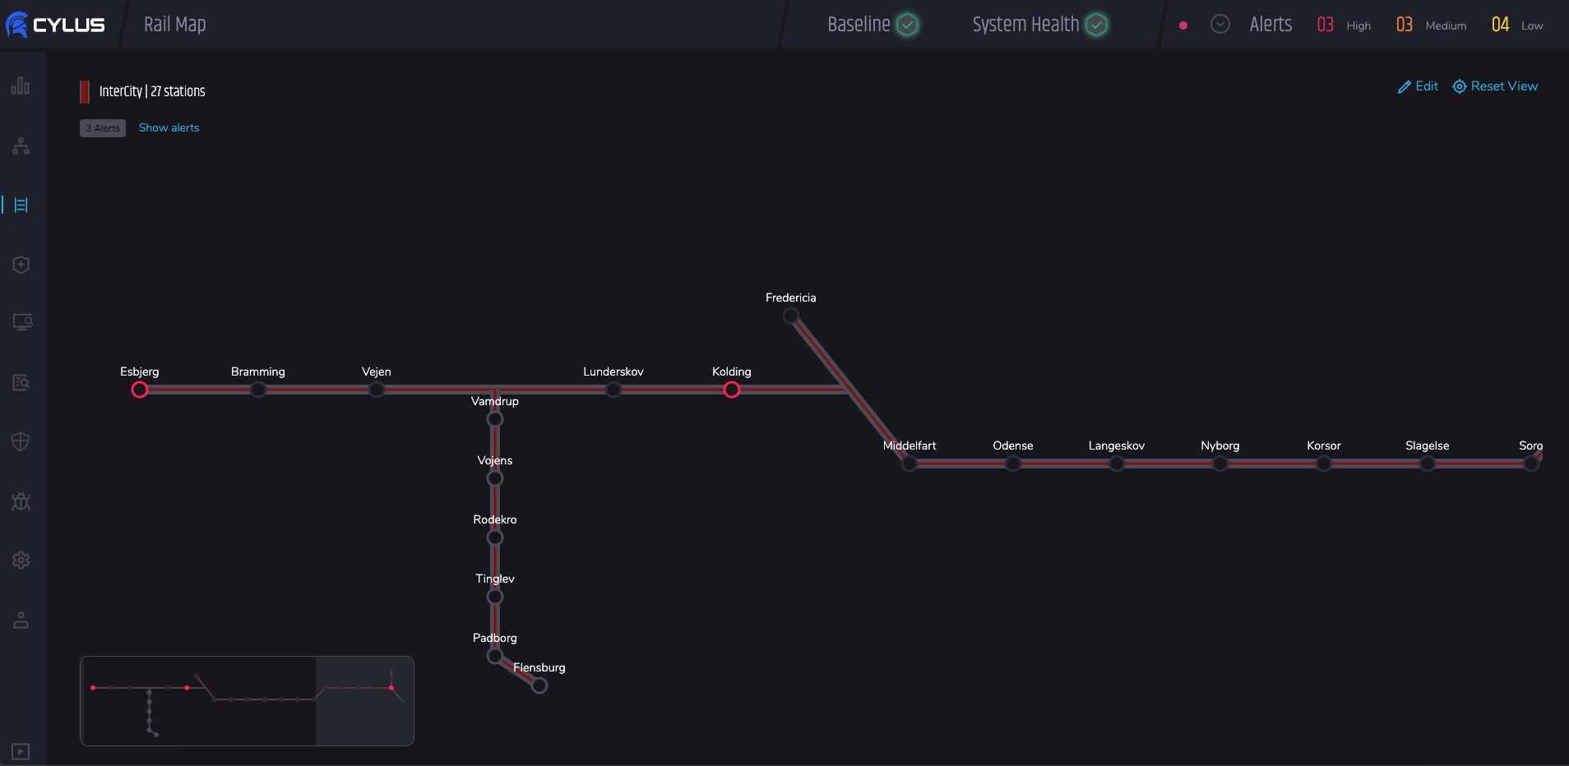
Use Case from Cylus: map
Notes:
a map….sounds not that important, but it is the easiest way people have to visualize locations of things. this also helps setting relations between events
first we had the asset map => based on networking, good for cyber
then added the SIG map => was good looking, but cyber people didn’t really used it
now we have the rail map => good compromise to allow
Those changes were born from our interactions with our customers where we also try to gather internal insights from teams outside the cyber team to get the best picture on their needs
bonus: customize your map easily for fine tuning

Slide 20
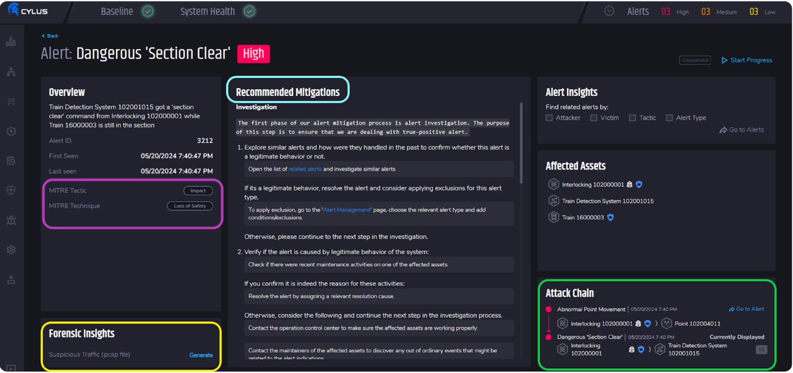
Alert enrichment
Notes:
Here we will find the different added data that CylusOne provides, based on the sequence’s slide

Slide 21
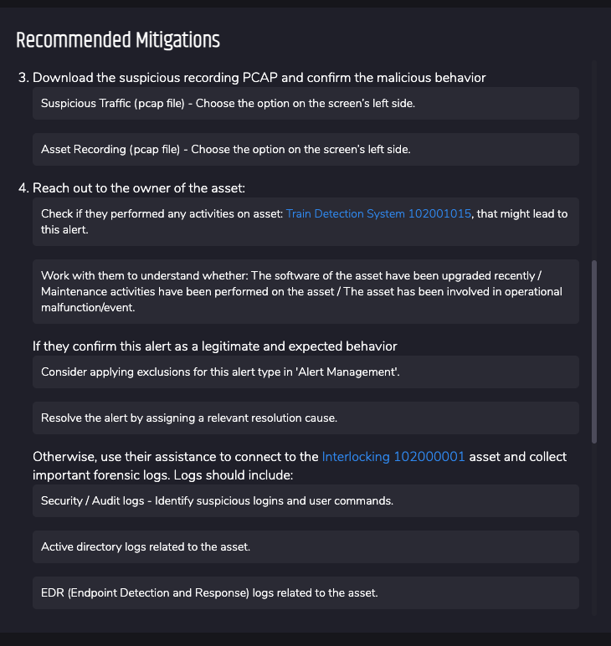
Use Case from Cylus: playbooks
Notes:
//change the picture here (bad resolution)
we changed the layout of the alerts page, to have a big space for “playbook”. This space is open and customizable so customers can have their own content, links to other systems or KB and such…

Slide 22
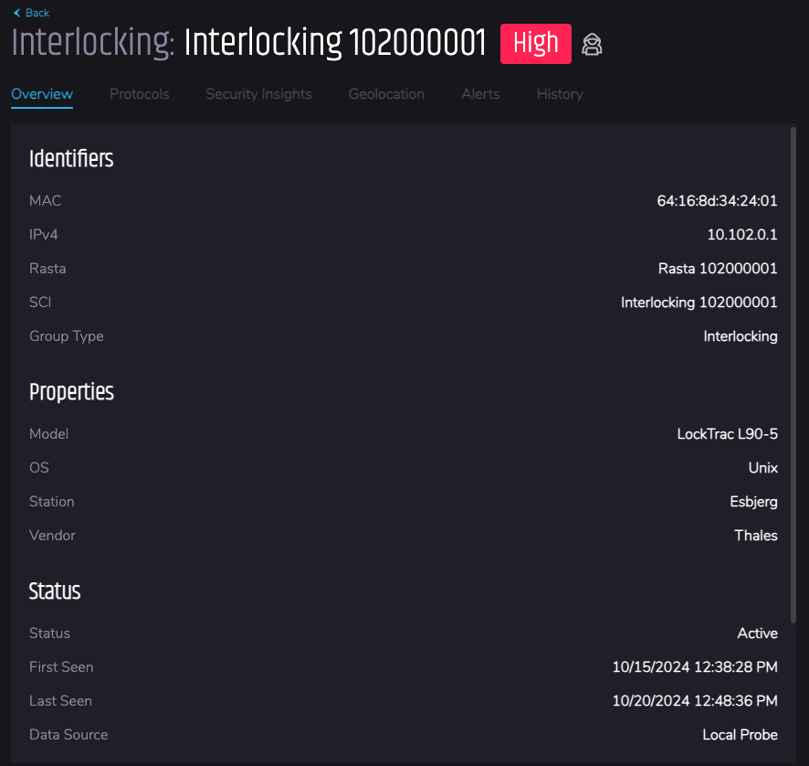
Use Case from Cylus: customized data enrichment
Notes:
Last point, how we added custom properties for the client, so they will be able to add translations. Because we classify asset by types, but to speed things up the SOC operators will want to have a fast reference to “the team in charge of those assets”. If they put the phone number of the team, it is just the quick link we can have between both entities.

Slide 23
Questions?

Slide 24
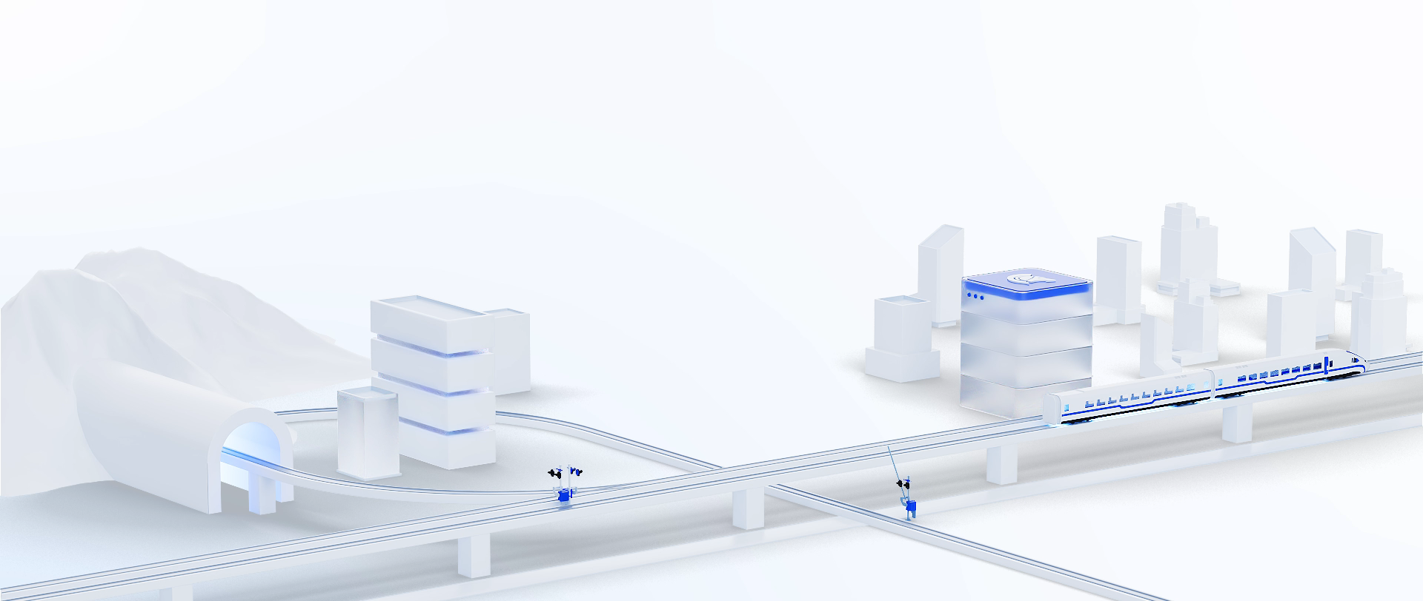
Leading rail transport toward a cyber-secure future.
Thank you
cylus.com

