Slide 1
Brownfield OT Systems Risk Assessment
Hack the Railroad 2024
AECOM
Manpreet Mann

Slide 2
Cyber Security Risk Assessment framework for OT Systems
An Operational Technology (OT) Risk Assessment Methodology is required
Risk Assessments were conducted using NIST and IEC 62443
NIST facilitates for a risk-based process
IEC provides controls and how to segregate OT Systems
CENELEC has developed TS 50701 that defines a risk assessment process based on IEC 62443
NIST 2.0 provides a new risk assessment framework
IEC 63452 is being developed

Slide 3
Risk Assessment Lifecycle
Regardless of the framework being utilized, the methodology is important:
Identification of System Under Consideration (SuC)
High Level/Initial Risk Assessment
Partitioning of the SuC
Create documentation for 1-3
Detailed Risk Assessment
Definition of Cyber Security Requirements
Cyber Security Assurance/Acceptance
Operations, Maintenance and Decommissioning Requirements

Slide 4
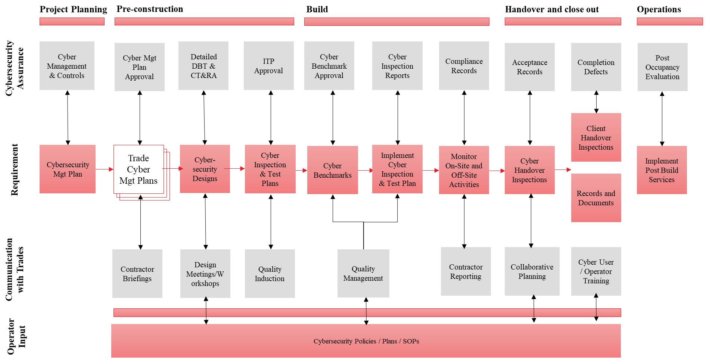
Cyber Security Assurance Process Flow

Slide 5
Greenfield vs Brownfield Projects
Greenfield Projects
New infrastructure
Possibility to introduce new technology
Capital budgets allow for advanced Cyber Security
Brownfield Projects
Existing infrastructure
Obsolescence management
Incremental upgrades do not allow for a “big bang” approach to Cyber Security

Slide 6
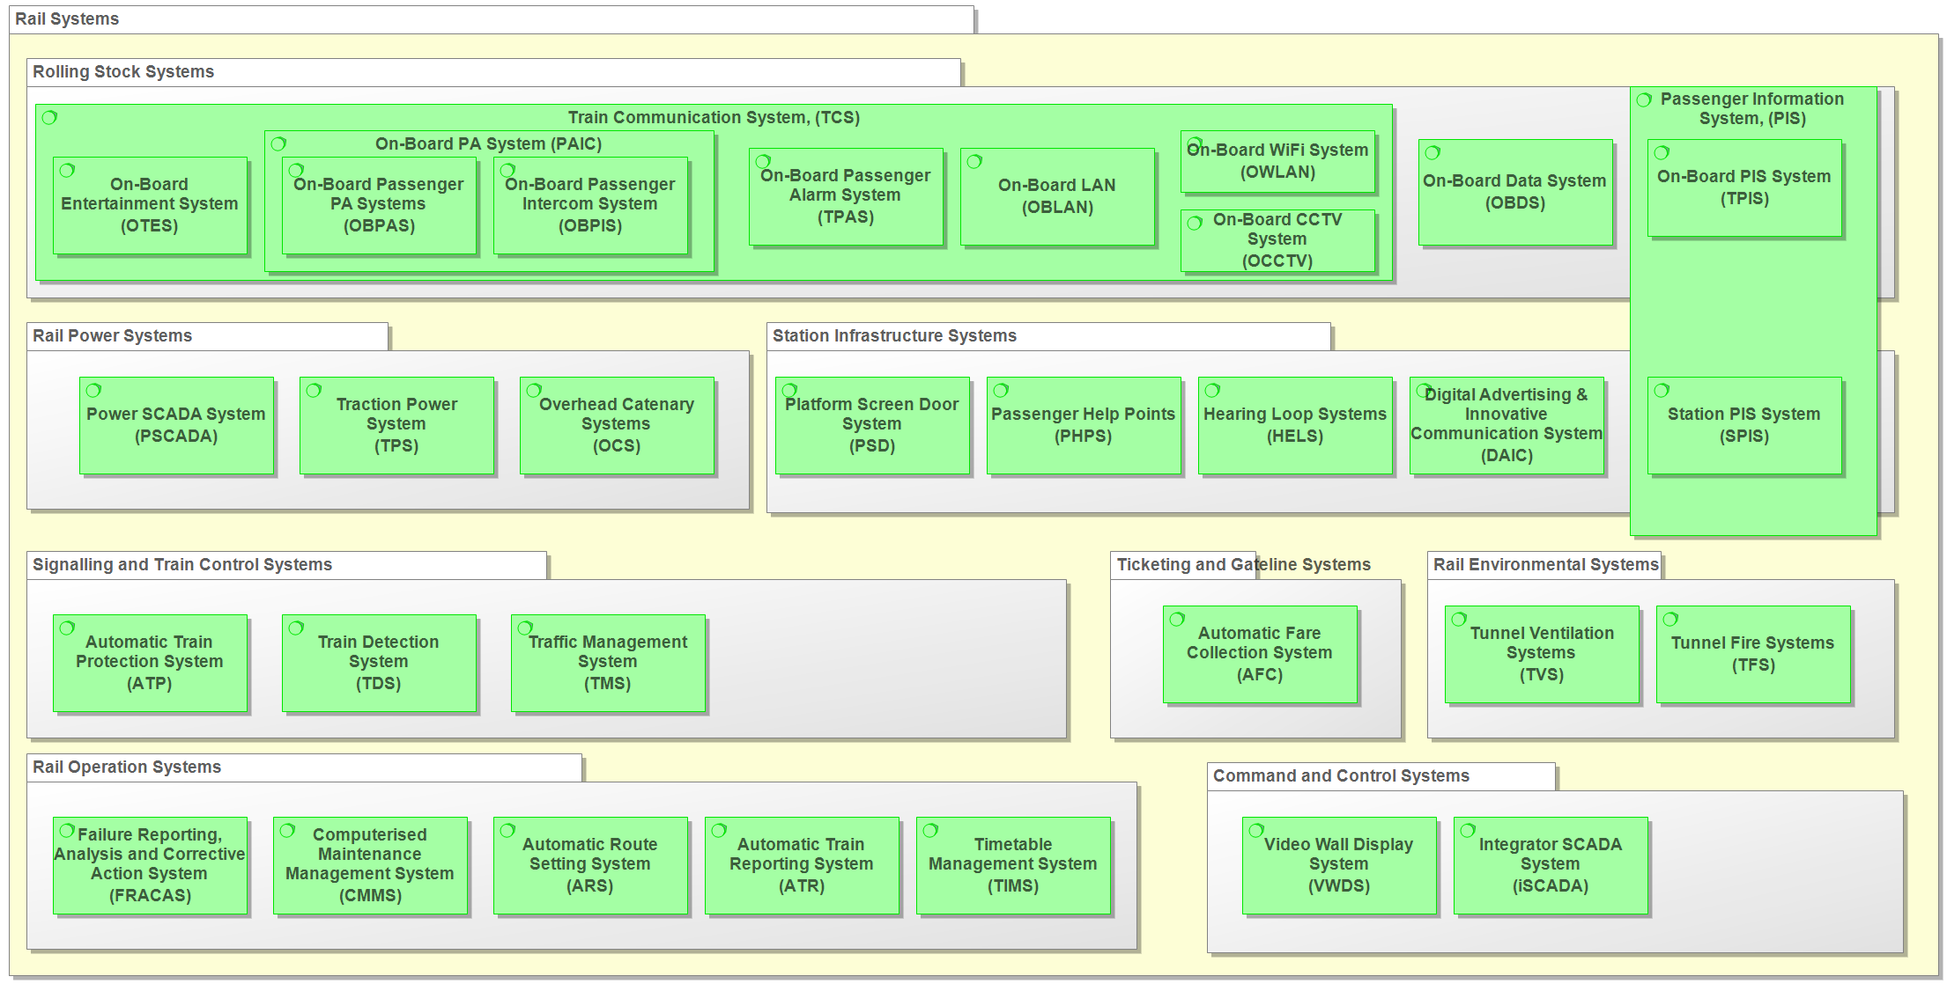
Case Study – CBTC Upgrade
Client is an operator and maintainer of a city-wide transportation system, which includes a light rail with CBTC system
The existing Signaling system was obsolete and they had a program to Upgrade the Control Center (OCC), Signaling System, New Vehicles and Retrofit Mid-Life vehicles
As part of the enhancement, the country’s directive was for operators to enhance cyber resilience as part of the upgrade
In addition, due to the enhancement, new networked devices would be introduced on the vehicles, trackside and OCC
However, some legacy components had to be retained as not all components need to be upgraded, especially if they are not at the end of life

Slide 7
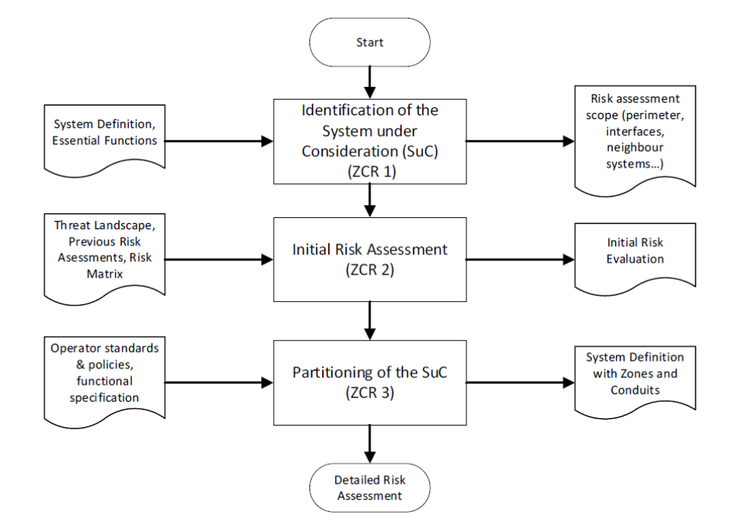
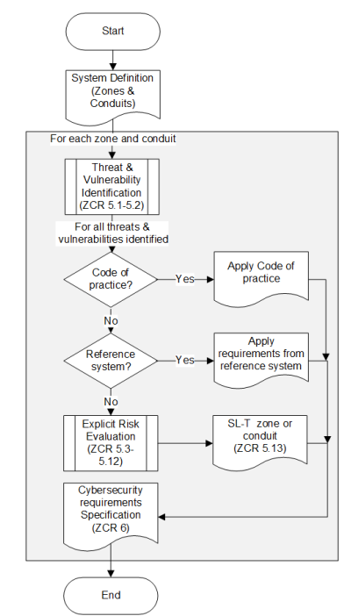
Case Study – CBTC Upgrade
It was determined that a combination of NIST and IEC 62443-3-3 would be used to perform a high-level risk assessment (now the TS 50701 can be used as well show on right)
  NIST defined the risk-based approach
  IEC 62443 defined zones, conduits and security levels achieved
The weaker components that remained in the system were segregated into zones behind strict network and physical controls forming zones with a higher target security level
  The network was deemed necessary to be upgraded to achieve controls needed
Once the Cyber Security architecture and High-Level risk assessment were completed a detailed risk assessment was carried out
  SL-T, SL-A and residual risks were captured

Slide 8
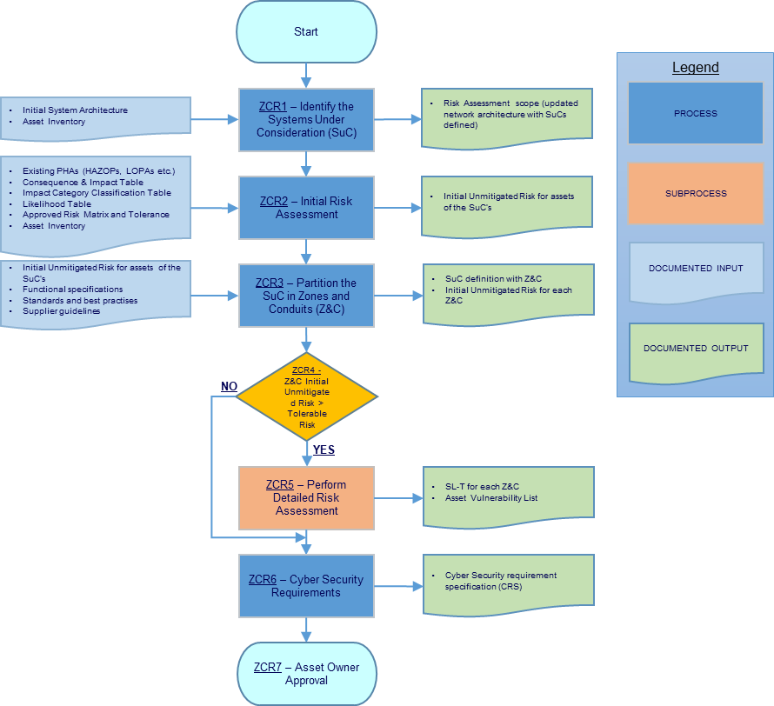
Case Study – CBTC Upgrade
The flowchart shows the process for the risk assessment that was followed that stems from IEC 62443
The Impact vs Probability table is used to inform risks that require mitigation (red) vs the ones that can be accepted (green)
Eventually a SuC was developed with appropriate zoning and a detailed risk assessment
TS 50701 covers similar process
 |  |  | Likelihood/ Probability
 |  |  | Incredible | Improbable | Remote | Occasional | Probable | Frequent
 |  |  | 1 | 2 | 3 | 4 | 5 | 6
Impact | Catastrophic | 4 | R4 1 | R3 8 | R2 12 | R1 16 | R1 24 | R1 24
 | Critical | 3 | R4 3 | R3 6 | R2 9 | R2 12 | R1 15 | R1 18
 | Marginal | 2 | R4 2 | R4 4 | R3 6 | R2 8 | R2 10 | R1 12
 | Insignificant | 1 | R4 1 | R4 2 | R4 3 | R4 4 | R3 5 | R2 6

Slide 9
Case Study – CBTC Upgrade
Eventually Risks were captured and were ranked with the associated acceptance level
Generally anything with a severity greater than 12 were deemed unacceptable risks that required design mitigation
The table to the right shows the classification of risks
Severity | Threshold Level | Risk Acceptance
> 12 | R1 | Unacceptable: risks at this level must be eliminated through design.
9 - 12 | R2 | Generally undesirable: action plans should be developed to reduce risk to a lower level.
5 - 8 | R3 | Generally undesirable: action plans should be developed to reduce risk to a lower level.
0 - 4 | R4 | Tolerable: severity is sufficiently low with current mitigations in place. Mitigations should be recorded in register, but further response should not be prioritised. Costs of further action should not outweigh any benefits gained from further severity reduction.

Slide 10
Case Study – CBTC Upgrade
After the detailed risk assessment, the following were implemented:
Centralized user and credential management system
IP/MPLS backbone with pseudo circuits limiting flow of communication
USB-whitelisting and disablement of USB ports where not required
Introduced an OT Intrusion Detection System with sensors connected at key locations within the network (architecture shown on the next slide)
Whitebox pen-testing was conducted to understand security implications of the new system with controls in place
O&M procedures to update the risk assessment annually with a possibility to pen-test if deemed necessary

Slide 11
Case Study – CBTC Upgrade
Operational Technology Sensors were placed in various zones via mirrored ports
These sensors collected MAC, IP and Protocol information to ensure only known devices communicate on the network with known protocols
All anomalies were transmitted back to SIEM in the Control Center
Effort was needed to reduce false alarms
SIEM
Control Center Network
Network Zone 1
Network Zone 2
Network Zone 3
Network Zone 4
Sensor
Sensor
Sensor
Sensor

Slide 12
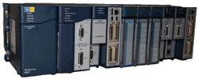
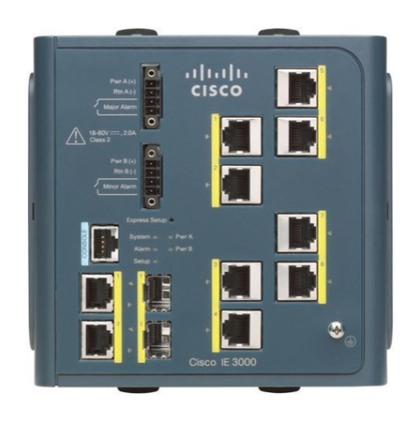
Case Study – Traction Power Substation (TPS) Vulnerability Assessment
Client is an operator and maintainer of a city-wide transportation system, which includes a light rail
As part of extending the line, it was deemed necessary to investigate the Cyber Resilience of existing PLC controlling/monitoring the TPS
The scope started with a Factory Test of just the PLC (GE Fanuc PLC) as a desktop study
Pen tests were conducted mostly by Fuzzing (sending erroneous inputs) and was deemed necessary to investigate further as part of Site Testing

Slide 13
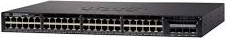

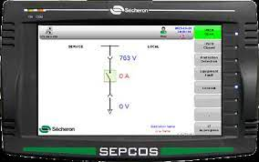
Case Study – Traction Power Substation (TPS) Vulnerability Assessment
For reference, the architecture of the sub-station is the following (focusing on SCADA/Network Components)
TPS Building
Control Center
RTU Cabinet
Control Center
Connection Switch
SCADA Workstation

Slide 14
Case Study – Traction Power Substation (TPS) Vulnerability Assessment
Initial Assessment of the PLC of the TPS
It was understood that the communication between the PLC and the OCC Workstation is encrypted
The network devices have Access Control Lists and some other security functions in place
After some investigation, the following was discovered
The communication was not encrypted, but encoded which allowed for reverse engineering of the protocol
The network devices did not have the necessary security functions enabled
PLC accepts commands from any device that can communicate with it
The relay protection cabinets have vulnerabilities that can impact the PLC

Slide 15
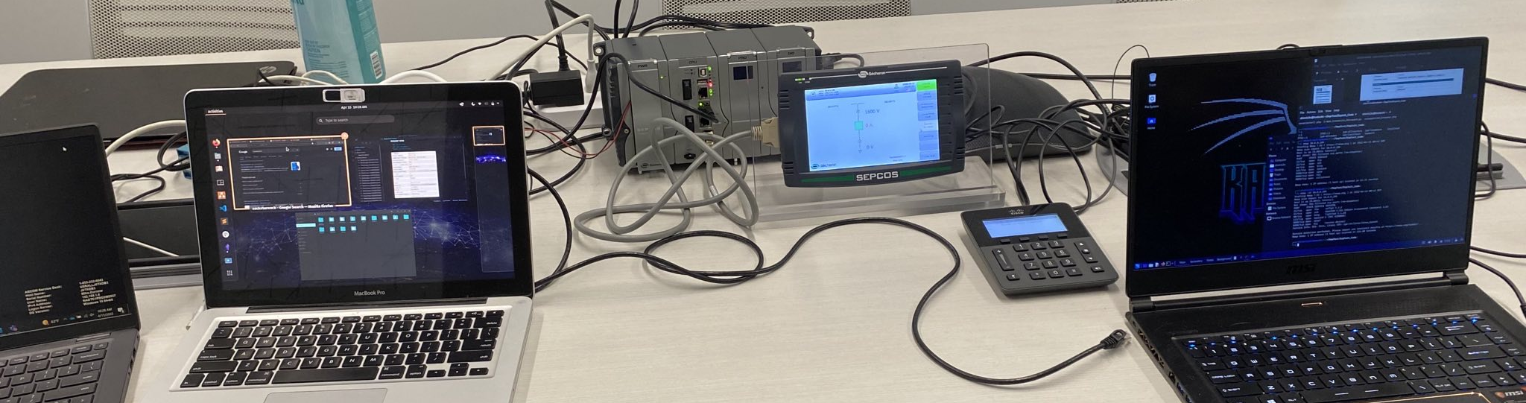
Case Study – Traction Power Substation (TPS) Vulnerability Assessment
After the initial testing and discovery at site the following enhancements were executed:
Updates to the network devices to include ACLs
Updates to procedures to validate logins to the network devices periodically
Patching of the Relay Protection devices due to a critical vulnerability
  An integrated Lab test was conducted to validate the patch

Slide 16
Case Studies – Key Takeaways
Even for brownfield upgrades, a Cyber Security by design process should be adopted from the inception to clearly visualize the risks
For OT Security defining zones and then securing them heavily with network components can reduce risks significantly
  Network Components can be upgraded in the future, but Control Systems are much harder to upgrade/patch
While a security incident can occur an OT IDS System (shall have low false alarms) that checks communication flows, unknown assets, and misconfigured devices can prevent/minimize availability impact

