Slide 1
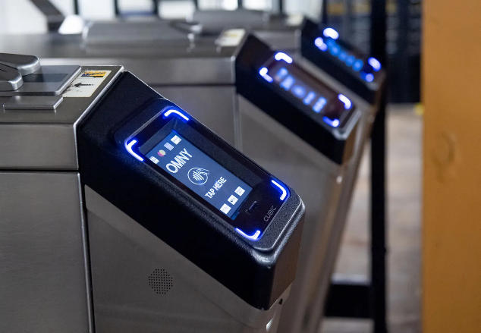
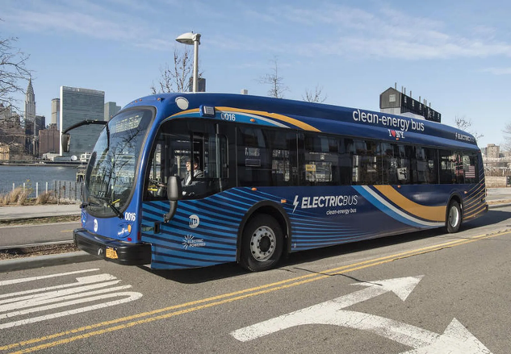
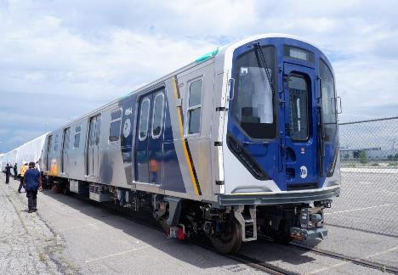
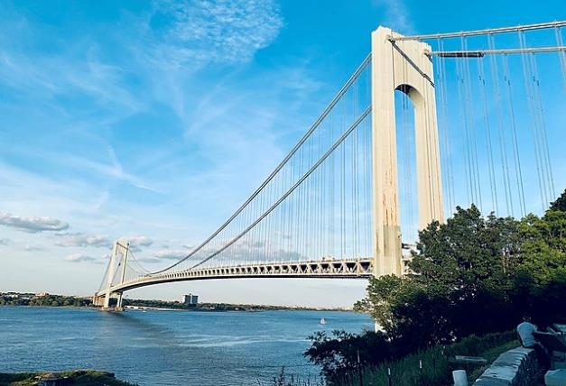
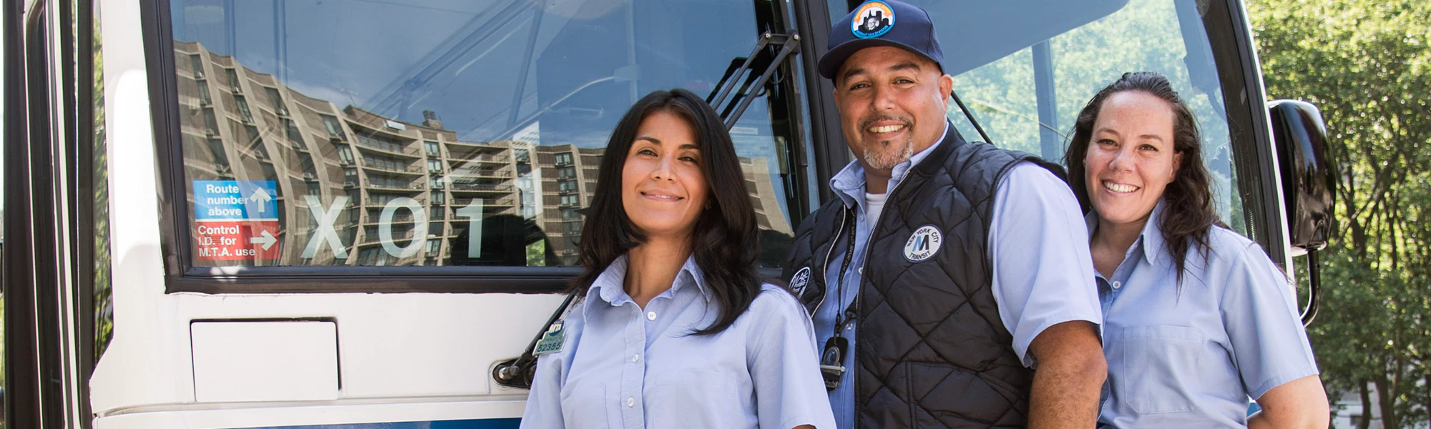
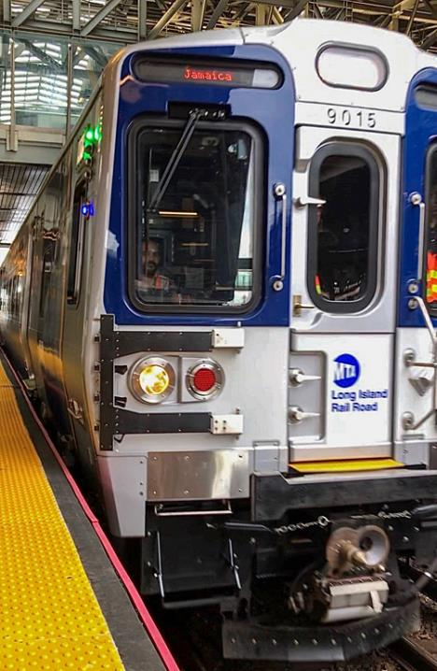
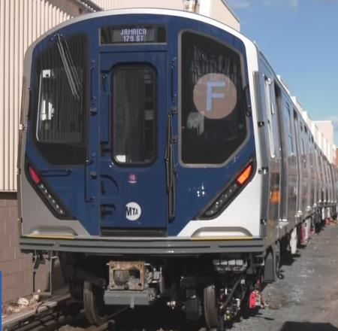
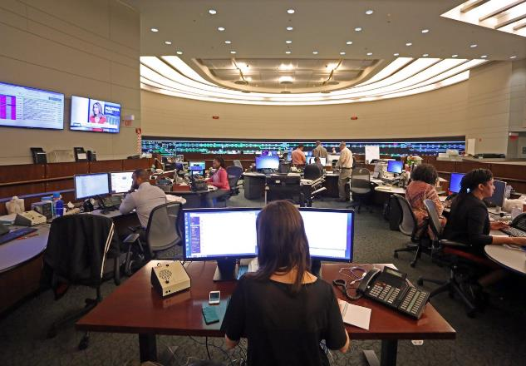
Cybersecurity
Tariq Habib
Tariq.Habib@MTAHQ.ORG

Slide 2
Securing Transportation Systems is difficult
Lighting
Fare Payment
Revenue System
Ventilation
Hydraulics
Fare Apps
Fire Safety
Radio
Wireless Provider
Life Safety
Fare Payment
Life Safety
Interlocking
Train Control
Video Displays
Comms
Customer Information Systems
SAFETY
Signaling
PA / PIS
SERVICE
Power
TCMS
Signaling
Water Drainage
Schedules
Train Control
CBTC
PTC
Websites
CCTV, Access
Power
Facilities
ATS
ATP
Traction
Notes:
Rail assets are not easy to protect. The list of systems involved in providing services is extremely large.

Slide 3

What is the Priority?
Legacy Rail Infrastructure
The systems we will have in the future
What should we be mostly concerned about?

Slide 4

5 Reasons
for Cyber Insecurity
Notes:
5 actions to fortify your human firewall
Image: Getty/Gartner Brand Center

Slide 5
1
Technical and
Security Debt
Trillions of Dollars of Unprotected Infrastructure
Not Hardened
Weak Authentication, Protocols, Processes

Slide 6
2
Culture and Behaviors
Cyber is not a Significant Risk
Resilient Operations and Absence of a Cyber Incident – overconfident
Lifetime of Operations Management with no security – the false sense of comfort

Slide 7
3
Lack of Technical Solutions
to Solve Common Problems
Few solutions for Legacy Tech
People needed to Custom-Build Solutions for Legacy Tech
Educating Vendor
CISA, TSA, APTA, and Industry need to work Towards it

Slide 8
4
Cyber Capabilities
Integrators are still Learning Cybersecurity
SOW Driven
Cyber Teams don’t Fully Understand the Operations and rail tech
Defending APT

Slide 9
5
Who is Paying?
Custom Solution
Expensive
Upgrade of Components

Slide 10




A product or system must enhance security & Integrate with the current cyber ecosystem
Most rail systems are operated by engineering and operations teams
Their primary focus is safety, reliability, and on time
Have plans for every situation except for Cyber
Invisible threat to rail/bus operation – no experience, example, or encounter
Engineers and operators do not fully trust IT – problems within IT systems
Imagine if CrowdStrike was present in Rail Operations
Cyber teams are not fully embedded into the operations
They are trying to get attention
Directives are not yet enforced
Product suppliers and integrators have not demonstrated that they understand what needs to be in place before the system is handed over to the Operations and Engineering team

Slide 11
Use case– Changing default passwords sounds simple! All 1, 2, 3, 4, 5 apply here
Many different types of assets where the problem exists
Operators’ needs are real – safety & availability over cyber concerns
24/7 availability
Don’t want to remember passwords,
Want automatic connectivity, no lockouts
Legacy hardware, not hardened, not patched
Physically secure
Multiple levels of failover, centralized and localized

Slide 12
Use case: Changing default passwords sounds simple! All 1, 2, 3, 4, 5 apply here
How to build authentication with a password without disrupting operations
No off-the-shelf solution or fix – the alternative is a costly upgrade
Custom solution – Isolate the network with auto login with strong remote access
Requires funding, buy-in, prioritization, and change management
Cost across all asset types is high
Implementation timeframes are 18-24 months
In the end, we have to decide whether password security is important or not !
→ Is Physical Security, Segmentation, and Isolation from the Internet enough?

Slide 13
Everyone agrees cybersecurity is important, but the priorities differ. We must continuously work to bring all the stakeholders together Cybersecurity will work when stakeholders are aligned
Supply Chain & Operators
Government and Industry Organizations
Suppliers
Agencies
National –US
Industry
Product Security
Project Delivery
Sales
Security SME?
Legal
Planning, Design
Procurement
Legal
IT
Cyber
Project Delivery
Operations & Maintenance
TSA
FRA
FTA
CISA
FBI
APTA
UITP
Consortium
ISA/IEC
62443
21434 / R155
Integrators
Whitehouse
Project Delivery
Sales
Technical
Legal
Security SME?
Cyber directorate
National Security Office
Align everyone to make our legacy world defensible.

Slide 14
What every rail operation must have in place? Is this sufficient to defend against advanced attacks?
Doable
Control remote access – we know who is connecting from outside
Isolation from the Internet - Make it difficult to attack Operations from anywhere
Strengthening corporate security – Advanced defensive capabilities are in place
Establish visibility – We can detect incidents in parts of operational areas
Improve monitoring processes –Train staff to know crown jewels, use cases
Segmentation – To limit the impact of attack, segmented critical systems
Incident Response and Recovery – Response and recovery is documents
Procurement controls to ensure cyber requirements are part of all contracts
Defined vulnerability and patch management process
Account management – AAA wherever you can**
Improve physical security of cyber assets
Notes:
Data governance,

Slide 15
Security controls that’s costly to incorporate in legacy systems
Expensive, long implementation timeframe
1 | Multi-step authentication - MFA
2 | Privileged access – Manage access for people who can impact the service
3 | Strong access and authentication – Enable similar practices in Operations
4 | Password controls – Hard to require passwords in Operations
5 | Full visibility – Know all your assets and ability to detect cyber attacks
6 | Recovery – Have a business recovery plan and supporting infrastructure
7 | Hardening and vulnerability management – build security controls on top of legacy infrastructure

Slide 16
How do we align to achieve success?
Organization’s Role
How can they help?
CISA
Provide actual solutions to the common challenges faced by critical infrastructure
FTA
Allocate a small percentage of all grants to cyber improvements of current systems
TSA
Work with the FTA, CISA to issue grants
Begin enforcing directives
Integrators
Sector specific solutions: Use the holistic approach to building defensive capabilities -- Beyond the SOW – Solutions for legacy tech
Suppliers
Build products with secure by design and default. Easily upgradeable and patchable – Educate customers about the right level of security
APTA, UTIP, Consortium
Educate, advocate, solutions
Agencies/Operators
Change behavior and make cyber a priority

Slide 17

Alignment across these objectives will accelerate security of transportation sector
Securing Operational Technologies and Critical Infrastructure
Crafting Solutions to improve Cybersecurity of Legacy and Future Systems
Align Objectives and Drivers for all Stakeholders
Understand Threats Levels and Cybersecurity Required Defenses
Effect Culture and Behavior Changes
Understand security is not cheap - Costs

Slide 18
Appendix

Slide 19
Prioritize your crown jewels
Top Priority Areas
Cybersecurity Program
Signaling systems
Improve organizational readiness to cybersecurity threats and incidents - critical systems incident response plans
Reduce the risk originating from partners and contractors that can impact operations and processes
Network Communication
Power
Access controls, system hardening
Improve application and cloud security practices.
Command Centers
Asset information, detection of cyber
Enable agencies’ operational technology teams to assist in cyber improvement – provide resources, infrastructure, and support.
CBTC Systems
Expand and improve on the Cybersecurity awareness and training program
Public Information Systems
Engage with your Procurement, Capital Program Management teams
Revenue Collection
Patch management process to secure systems – in progress

Slide 20
Case Study – Changing default passwords
CISO action: Send an e-mail to stakeholders to change your default passwords – please see CISA advisory
CISO doubts: Did they change the passwords? Probably not, since CISO doesn’t get any questions
CISO – Asks his pen testing team. Their findings are scary because they discover default passwords everywhere.
CISO: What happened to the password policy
These systems were deployed 20 years ago. That explains it
CISOs is concerned that they have default passwords. What to do
He runs to the leadership team, telling them we have a problem that must be fixed.
They say go work with the ops team.
There is an emergency meeting with the ops team.
They say they want these HMIs to be always on. They want a system that auto-logs in because they are not always there, and the system needs to continuously collect performance and maintenance data.
They have power outages and are not always here.
Here is a dilemma: the operations team has a good reason. They are more concerned about safety but don’t see cyber as a threat.
There is no technical solution for this problem of safety over cyber issue.
Eventually, the proposal is to create a localized segment not connected to the network and additional hardware for the insecure PLC for remote access.
Hundreds of locations, the cost is high, budget is tight.
Once the funding is available, hardware is procured, tested, and installed, 2 years have passed.
This is just one class of assets, but we have many.
What action would you take if you were faced with this over and over and over again?
Do nothing, or try to fix what you can but it’s going to be a long timeframe.

