Slide 1




Voc Technology Group
Elevating Rail Cybersecurity
Through the Configuration Management Database (CMDB)
Hack The Railroad 2024
calvingeraldkornmann

Slide 2

Introduction
About Calvin Gerald-Kornmann
Overview of Research
Methods
Why this and Why Now?
Let’s Talk Configuration Management Database

Slide 3
Rail = Backbone
The rail industry plays a vital role in the transportation of goods and people, making it a critical infrastructure sector that must prioritize cybersecurity enabling integration of agency and community support to mitigate security incidents and ensure proper training and preparation in the event of a security incident

Slide 4
Current Landscape
Digital Transformation and Modernization Initiatives are in progress within the rail industry to support strategic and operational goals
Increased vulnerability with transformation efforts and integrating infrastructure to support the mission
There have been cybersecurity events that impacted rail

Slide 5
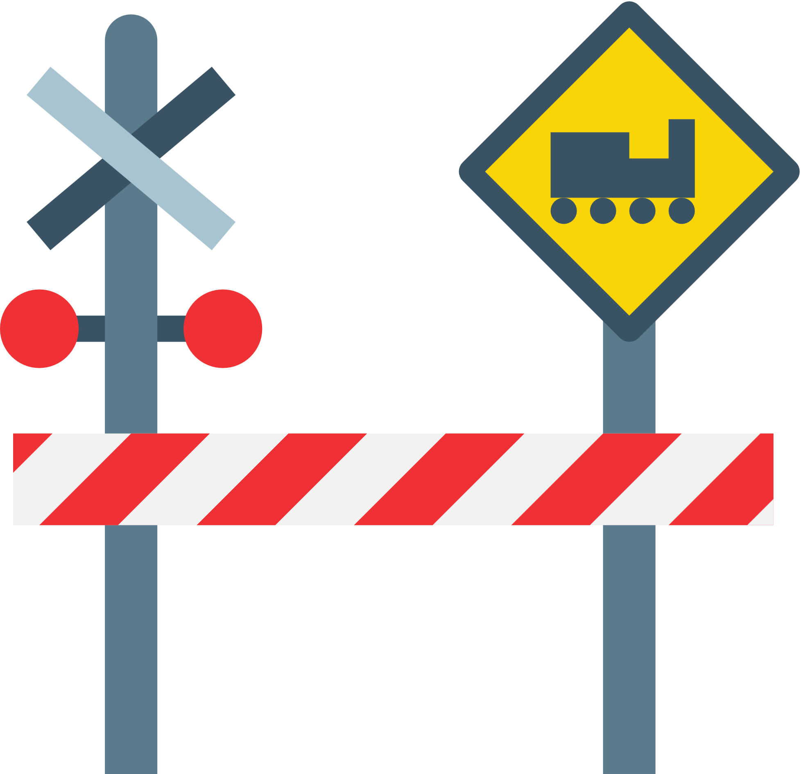

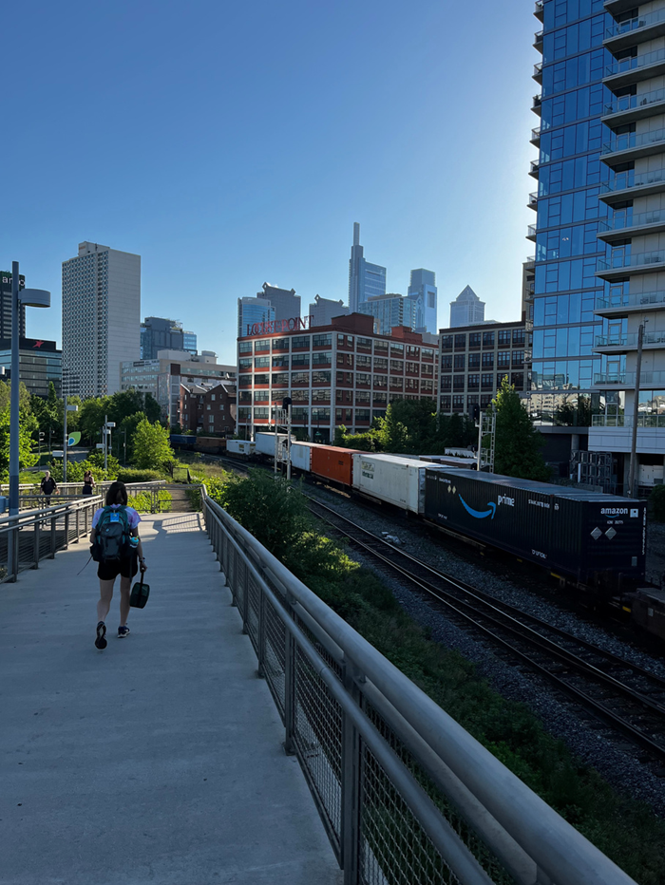



An Event Occurs

Slide 6







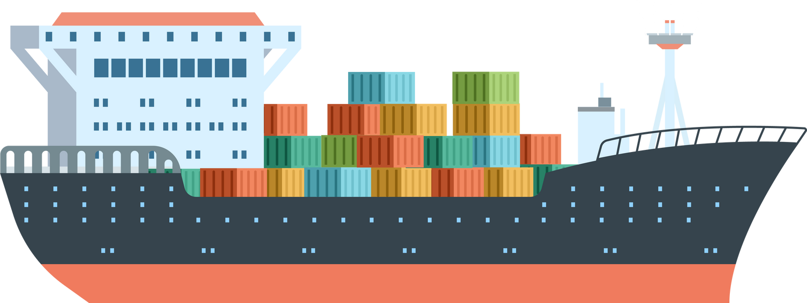
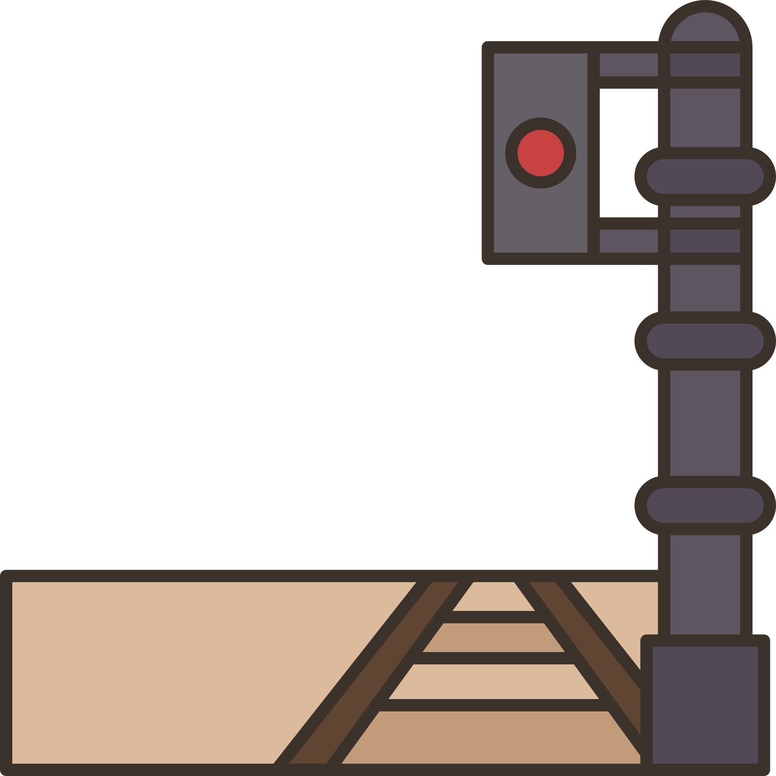



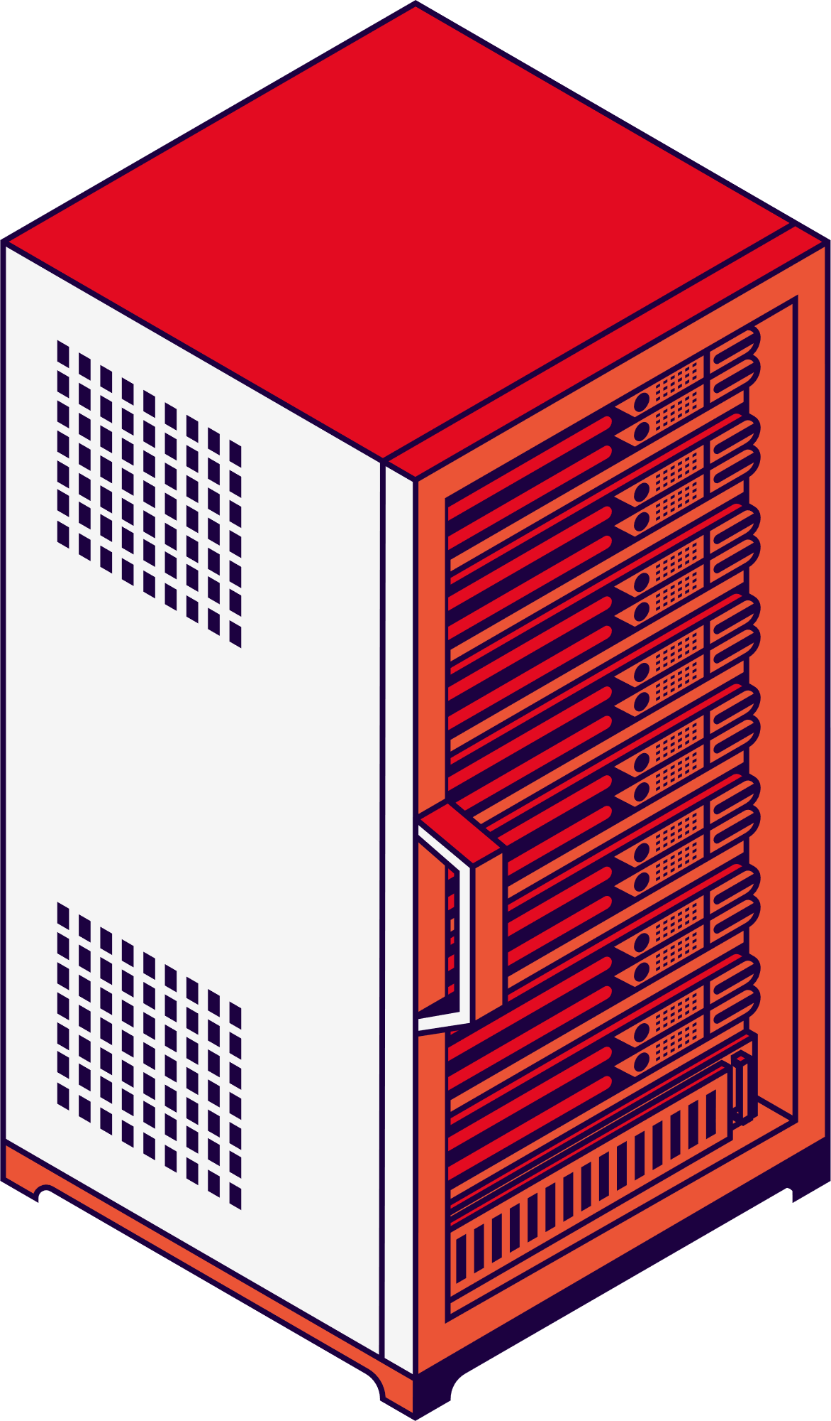

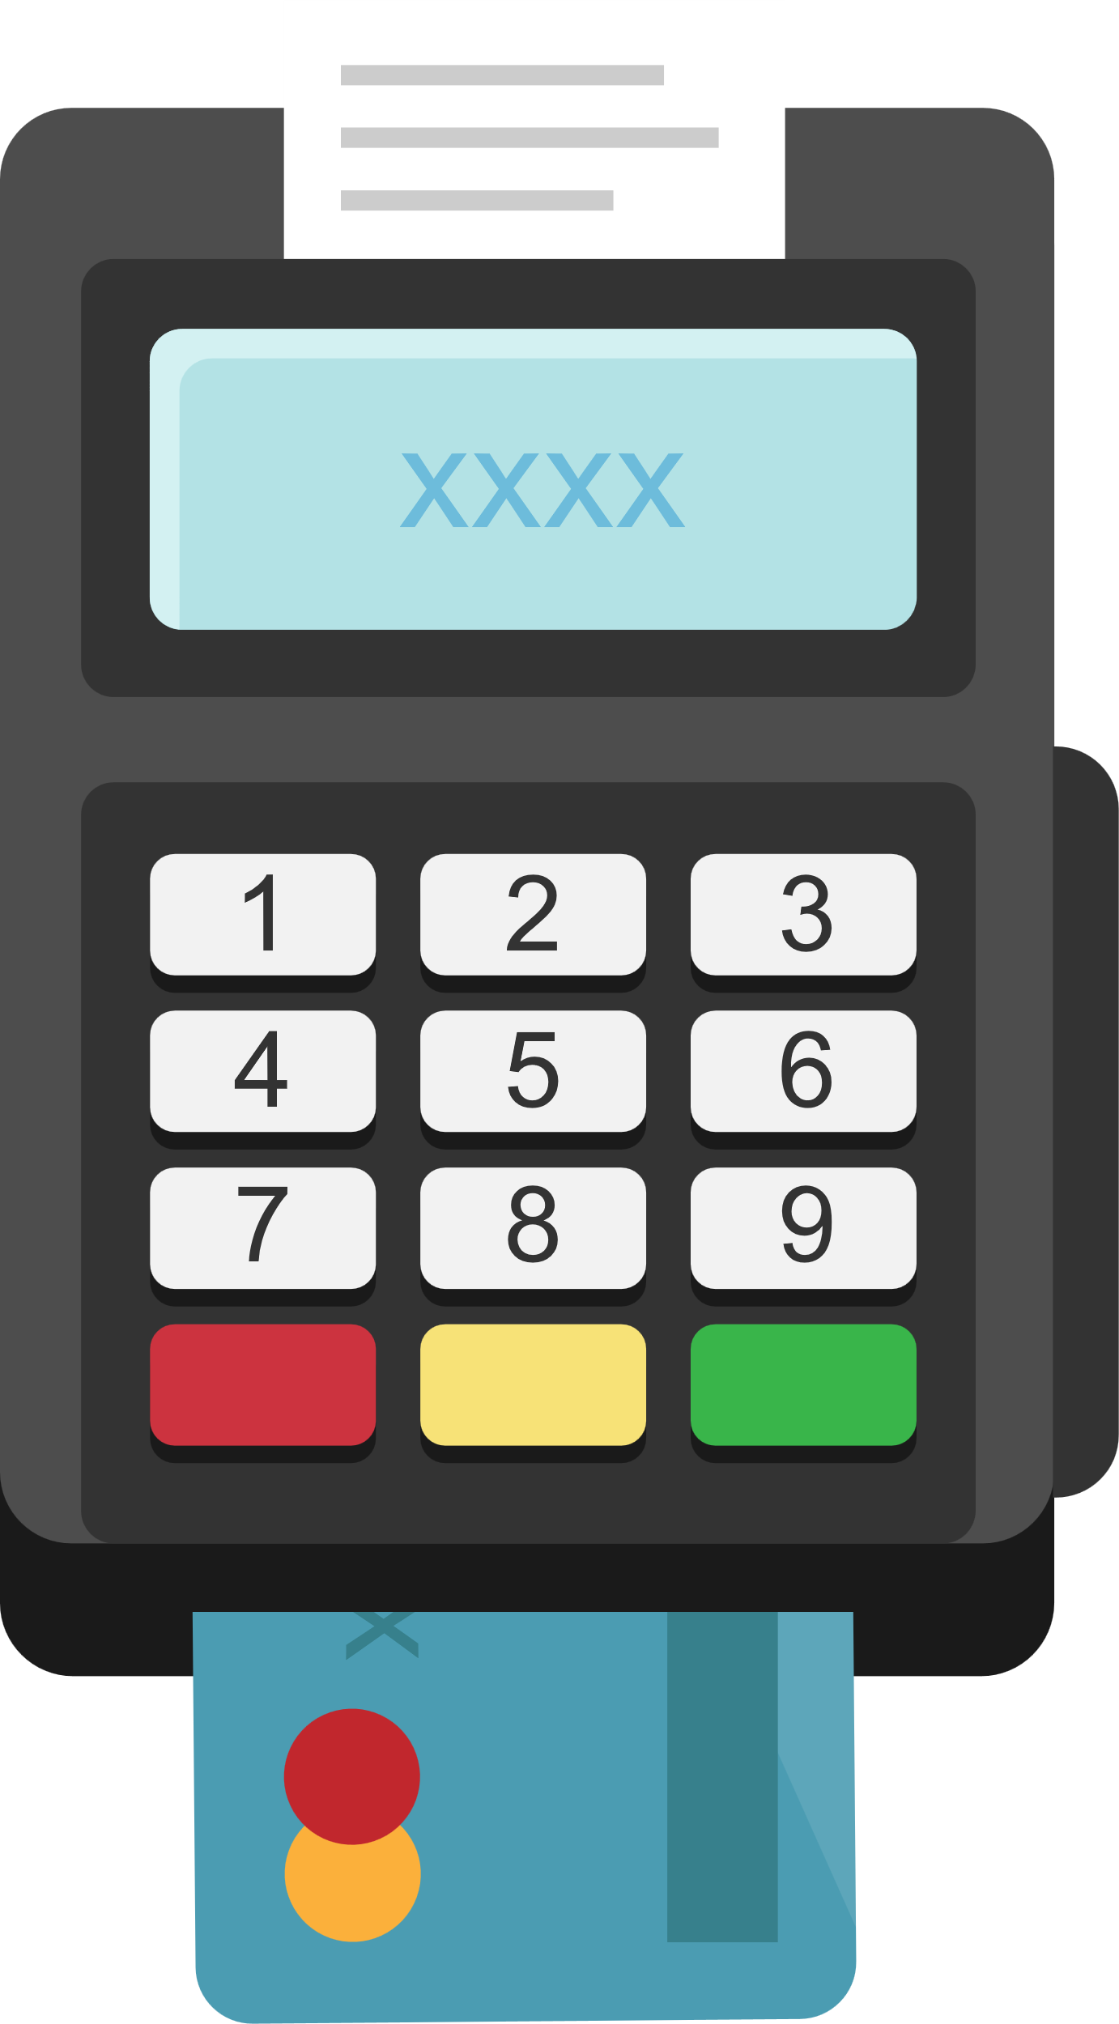


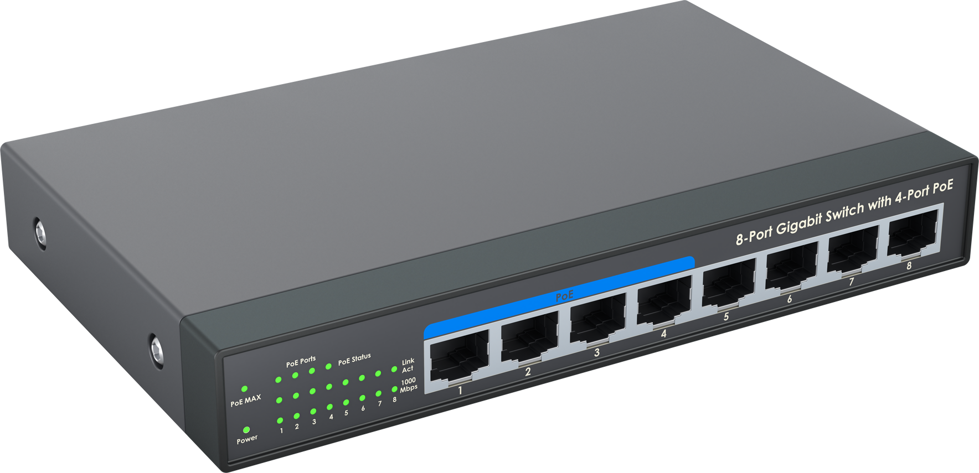
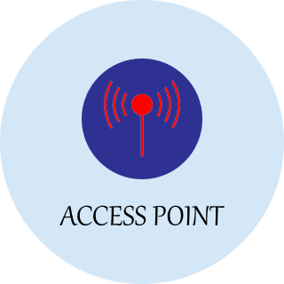



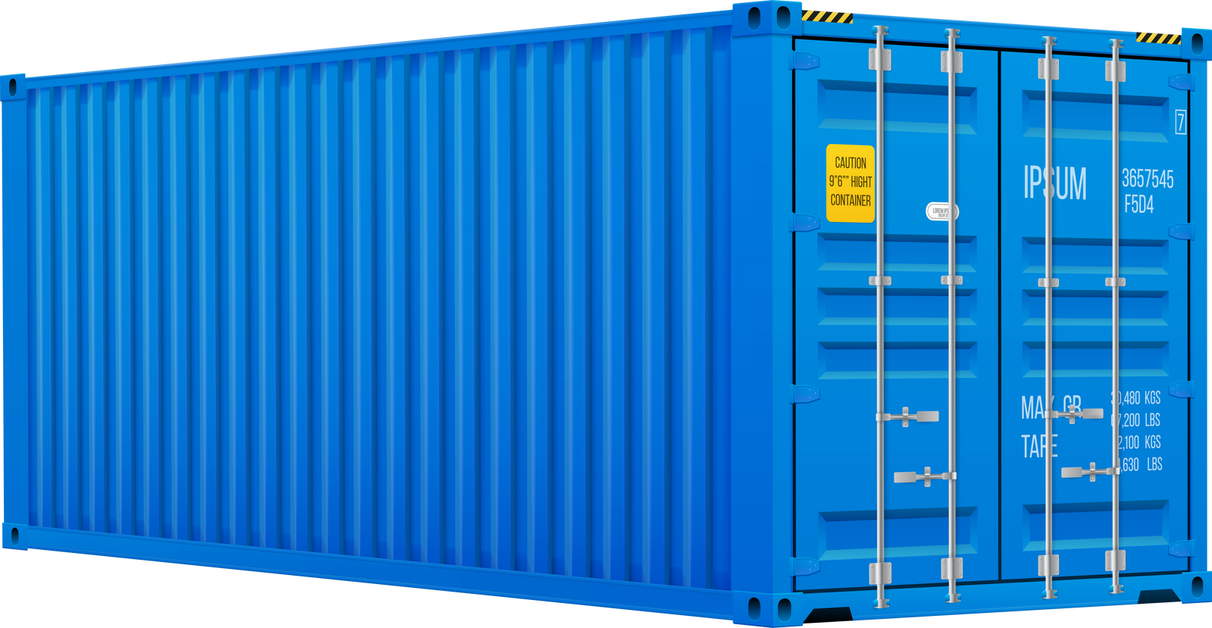
Configuration Landscape

Slide 7
Event Impact Assessment
Event Costing
Event Capture
Event Notification
Event Reporting
Associated Cost Estimate Pre-Closure of Company Internal costs and External Costs to community based on goods delievered, employment (based on user population impacted), impact to land and agriculture (based on goods, services, and human capital of the area impacted)
Regulatory & Compliance Data for Reporting
Data Compliance
Impact of Change and associated LOE/ETA
Event
Security Event (Type)
Event Caused by Change
Assessment of Event
CI involved in incident
Event CI Details:
User Data
Location
Services Impacted
Related Data
Human Capital Needed
Triage and Assessment Initiated / Automation
Predict issues from log anomalies
Targeted Communications based on Event (CI Data)
Security Event Playbooks (ServiceNow) & Integration
Self Healing (Future State)
Targeted Assignment Group for Triage, Dispatch, Emergency Management, Regulations
Estimate of Cost Based on CI and User Data
Shipping Routes and Associated Human Capital supporting this product
Regulatory and Security Compliance Reporting
End to End Visibility of the Security Event Impact from Field Operations to HQ
Ability to assess human and environmental impact
Opportunity to increase community knowledge on security and rail operations
Real time communication from end customer to agencies
Ability to identify & prioritize cybersecurity initiatives

Slide 8
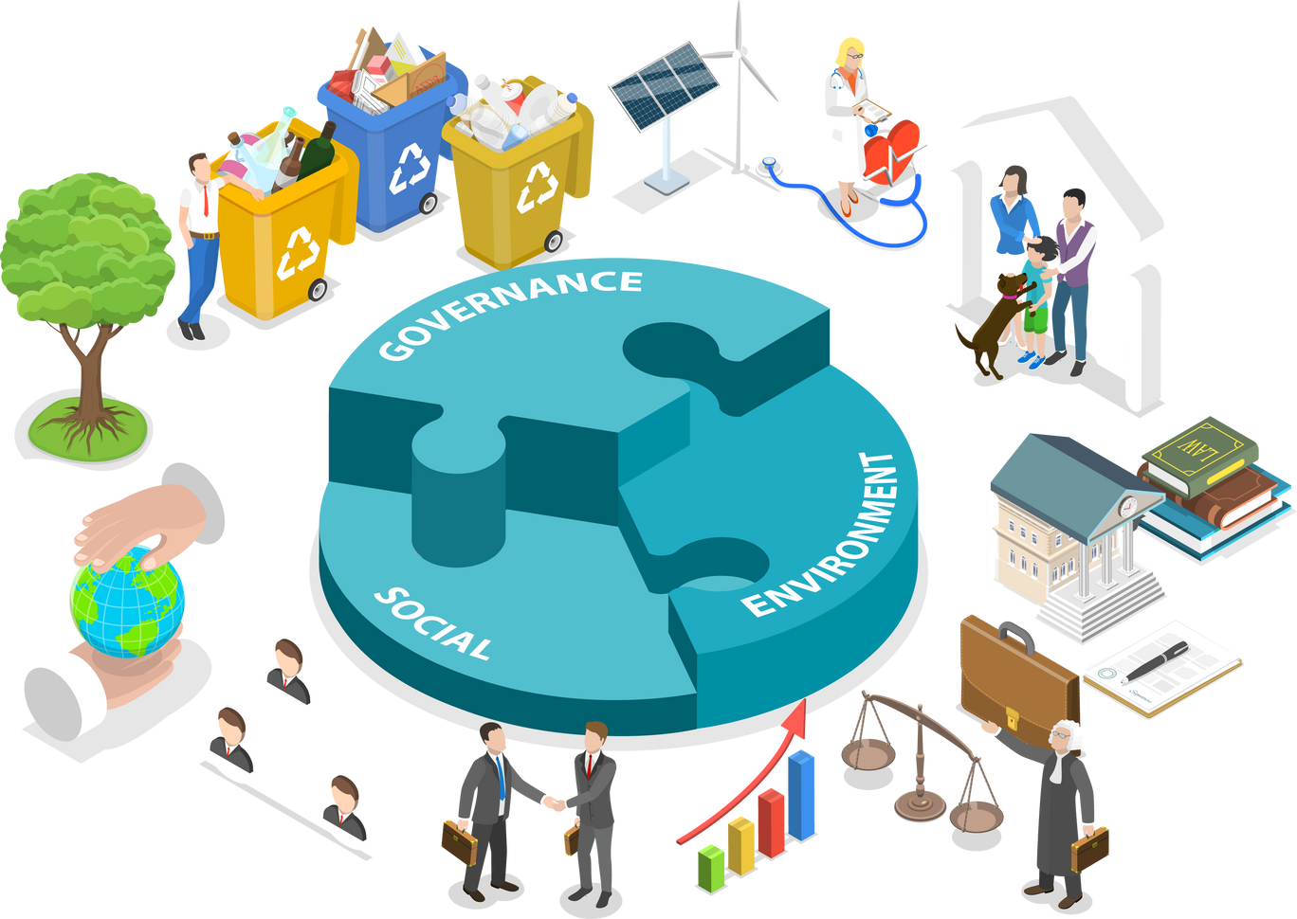


Assessment Impact to Community
Community
Community Operations
Federal, State, Local
Safety and Economic Data
Health Costs
Impact to Employment
Impact to Housing
Impact to Business
Service Disruptions
Goods Being Delivered / Picked Up
Passenger Rail
Data Breaches
Economic Impact to Employment, Goods and Services
Agricultural Impact
Wildlife Impact
Delivery of Goods and Services
Transportation - Employment
Transportation - Personal
Transportation - Commercial
Data Breaches
Safety Risks
Regulatory Compliance
Financial Cost
Unemployment Insurance
Insurance, Private / Commercial
Vendor Impact + End Customer
Human Capital
Regulatory Response
Event Data
Community Data
Community Operations Data
Economic Impact
Event Data
Community Data
Public Safety
Agencies and Support Identified based on Community Data
Federal Assessment & Final Closure
Community Enablement

Slide 9

CMDB
A configuration management database (CMDB) is a centralized file that functions as a comprehensive data warehouse, organizing information about an IT environment. CMDB clarifies the relationships between hardware, software components, and networks for improved configuration management

Slide 10
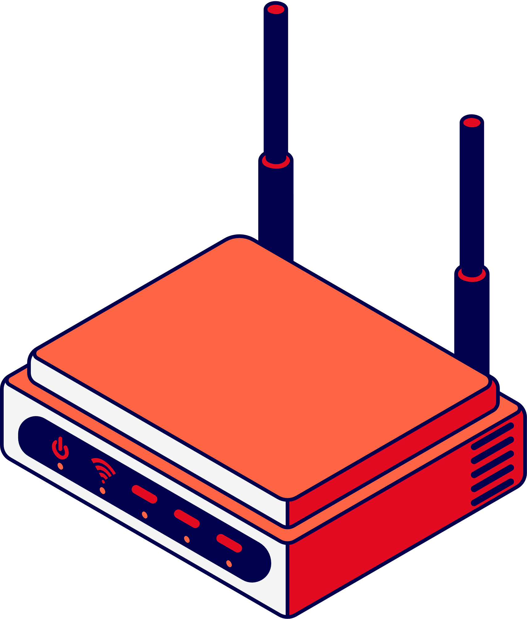

Benefits of the CMDB
Centralized Information
A CMDB acts as a single source of truth for all IT assets and their configurations with the ability to view these IT assets and their relationships to services, locations, and people (internally and externally). This includes services provided to users and the infrastructure that supports them.
Improved Decision Making
With improved Asset Visibility, Enhanced Security Response, Integration to Security Tools, Vulnerability Management, Access Control and Compliance, Automated-Decision Making, AI/ML, Metrics and Reporting; stakeholders are decisons are based on current and historical data that includes related current and historical financial data (with audit logs)

Slide 11
Benefits of the CMDB
Integration to Security Tools
A CMDB can integrate with other security tools such as SIEM Platforms, ThreatIntelligence Feeds, Vulnerability Management tools, Dataloss prevention, and rail cyber security platforms providing a holistic view of the organizations security posture enabling proactive threat management providing the ability to create events, thresholds based on regulatory compliance and controls
Compliance & Vendor Management
Your Configuration Management Database (CMDB) Governance should align to guidance from regulatory and security controls. This ensures as you configure events or populate the CMDB with CIs these data records reflect the data points needed to support your cybersecurity initiatives (configuring fields to populate data).

Slide 12
An Event Occurs

Slide 13
CMDB Integration

Slide 14
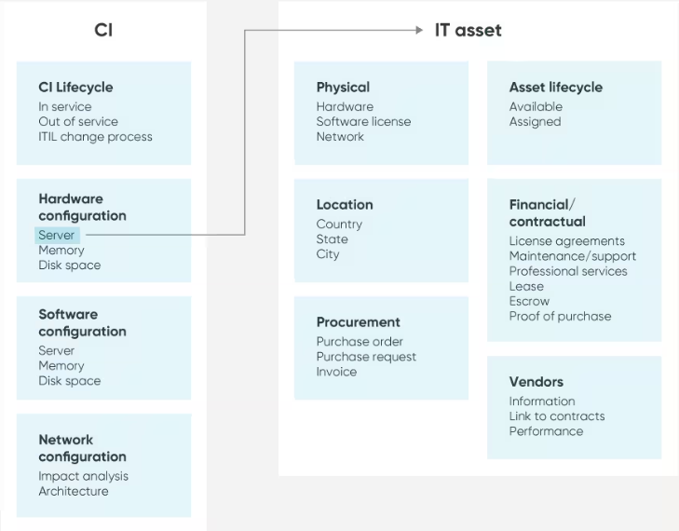
CMDB Integration

Slide 15
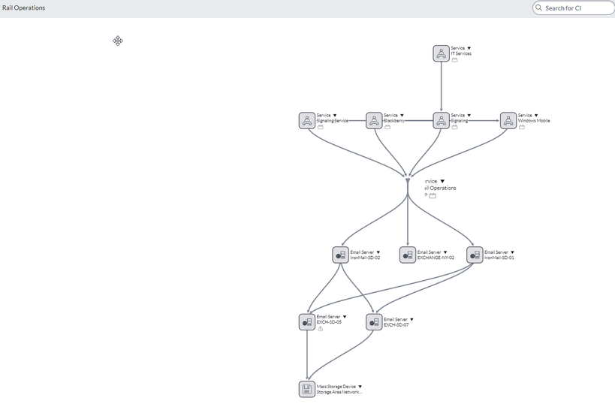
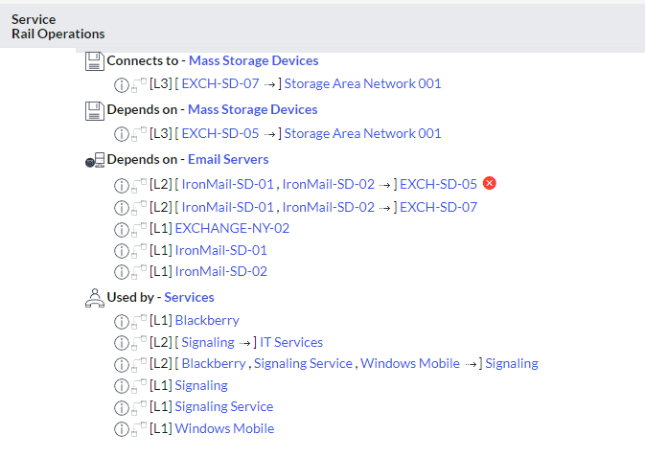
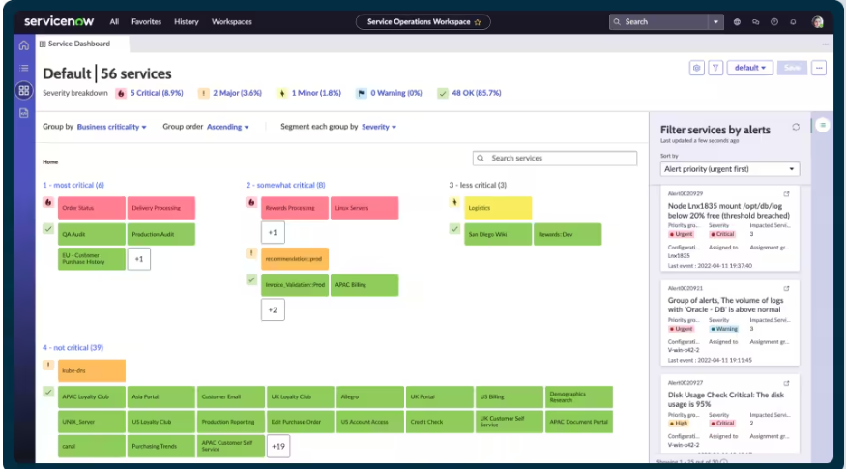
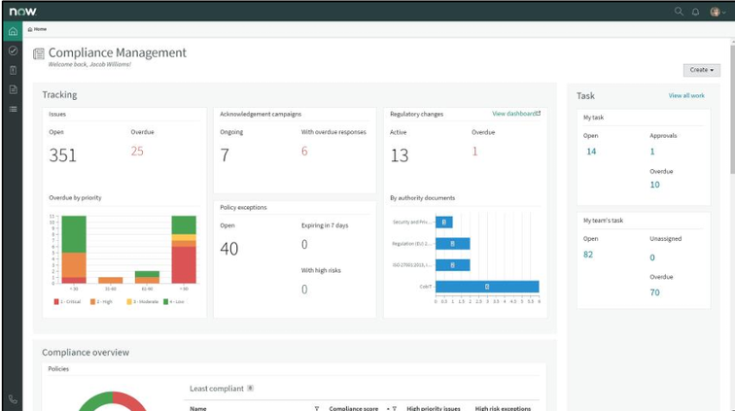
CMDB Integration

Slide 16
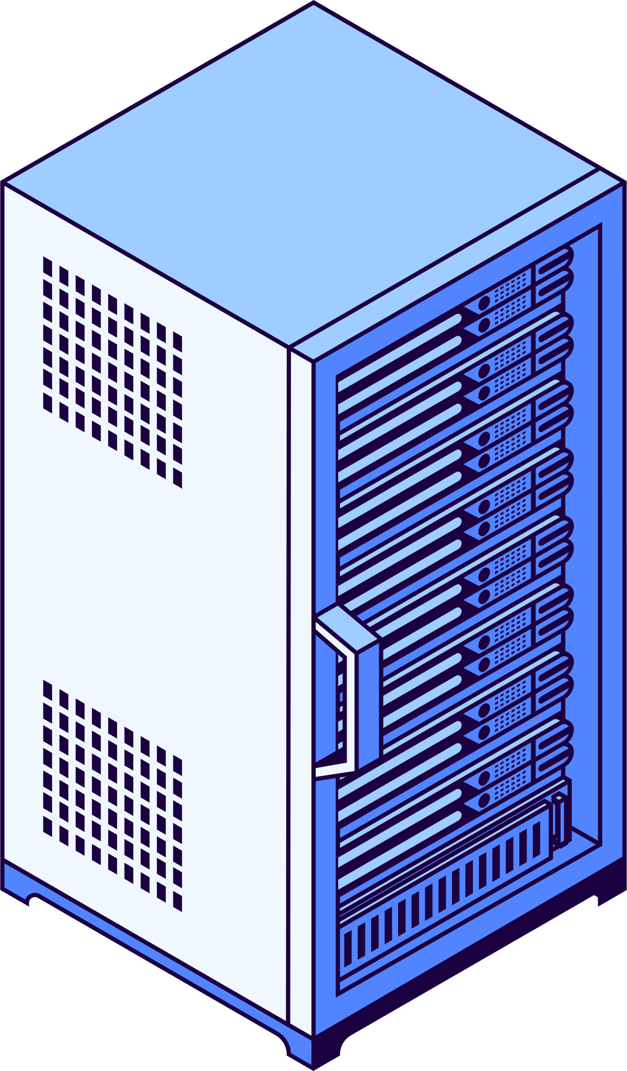
CMDB Cybersecurity Readiness
Here are some ways to initiate your Configuration Management Plan
Organizational Change Management / Configuration Management Governance (Cybersecurity Initiatives)
Workflow Automation Platform Capabilities
Incident Management
Compliance & Reporting / Analytics Capabilities
Vendor Risk Management
Customer Service Management
IT Operations Management
Strategic Portfolio Management
Integration to Rail Security Platforms
Secure By Design CISA
CISA Cybersecurity Webinars
Review Regulatory Compliance
If you are unsure get engaged in the ecosystem, it’s going to take everyone

Slide 17




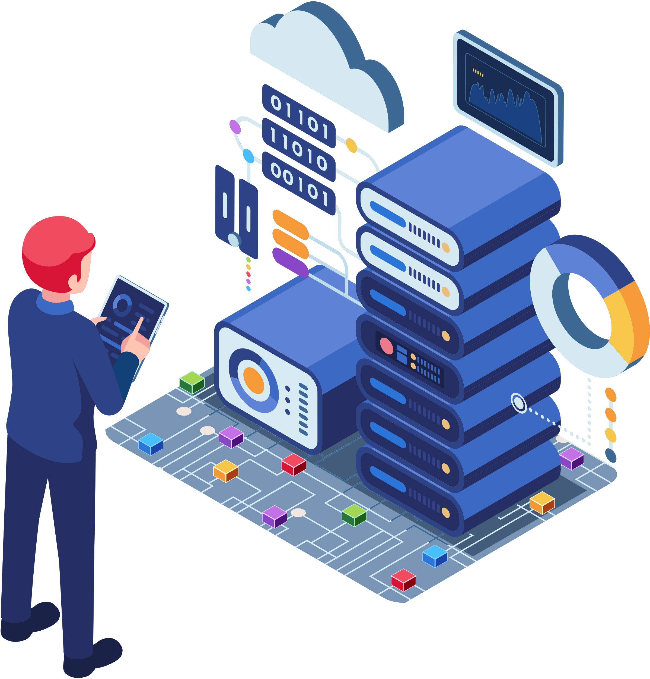


CMDB Pathway To Readiness

Slide 18
Get Started
Community
Community Operations
Federal, State, Local
Community Engagement to Support Emergency Management Protocols
Rail Safety and Cybersecurity
Apprenticeship Programs and Internal Human Capital (Companies in Community)
Environmental Engagement
Community Safety (pedestrian and vehicular awareness)
Communications on what to expect
Engagement during cybersecurity event
Vendor Risk Management Protocols
Cybersecurity Playbooks and Automation
Field Service Operations Playbook
Communication and Continuation of Operations
Estimated Organization Cost Impact Based on CIs Data: Services, Users, Locations, Goods Delivered
Engagement with Community and Service Providers
Prioritize Security Strategic and Operational Goals
Regulatory Compliance Data and Reporting
Historical Cost of Security event and associated data to support: Housing and Development, Labor, Social Services, Health Services, Environmental Impact Actions and Policy to support Cybersecurity Initiatives
Foundation to support end to end mapping of rail routes to estimate impact at each phase of an event

Slide 19


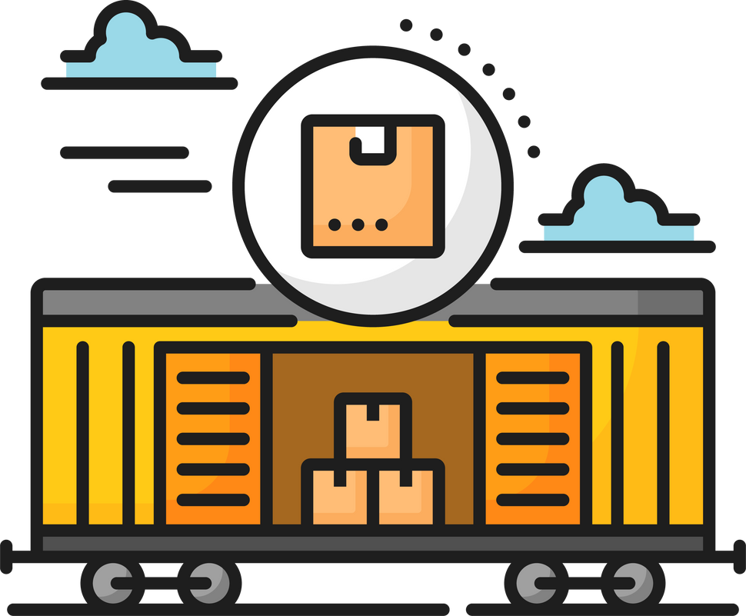
Future Considerations
Integrations with Platform As Service (PaaS)
CMDB Integration with Aviation, Shipping Container
Creating Integrated Cybersecurity Ecosystem for CMDB All Transportation Verticals
Monthly Training and Awareness with organizations and service providers
Community Engagement

Slide 20
Together
lets
Win
Notes:
Thank you for this opportunity and thank you

